Slide 1
Front End Engineering-I Project
Team Details:
Devansh Shandilya(2210990261)
Devanshi Dadwal(2210990262)
Devanshu Singh(2210990263)
Devashish Singh Thapa(2210990264)
Faculty Coordinator:
:
Chitkara University Institute of Engineering and Technology,
Chitkara University, Punjab

Slide 2
Table of Contents
Introduction
Problem Statement
Technical Details
Key Features
Project Highlights
Bonus Feature(optional)
Conclusion
References/Links used

Slide 3
Introduction
The title of the project is “Tribute To The Indian Armed Forces”, the team that worked on this project includes Devansh(2210990261), Devanshi(2210990262), Devanshu(2210990263) and Devashish(2210990264) respectively. The purpose of this project is to give pay tribute to the Indian Armed Forces who have been fighting for the nation throughout decades and to honour all their sacrifices and efforts in order to maintain peace in the nation pf India.

Slide 4
Problem Statement
This project aims to pay tribute to the Indian Armed Forces who have been defending this nation for several decades and to honour all the sacrifices that have been made in order to maintain the peace that has kept this nation intact and united for so long.

Slide 5
Technical Details
This project was made using HTML, CSS and JavaScript, which were used to create the Tribute Page using Visual Studio Code IDE.

Slide 6
Key Features
This project contains project contains features such as an forum which requires a name to be entered and a comment, to discuss whatever any visitor wants to talk about in public.
This project also contains a send your tribute box at the bottom of tribute page where user can send their own little or long tribute message after entering their email and name, and we receive the message on our email linked to the feature as soon as they click on send.

Slide 7
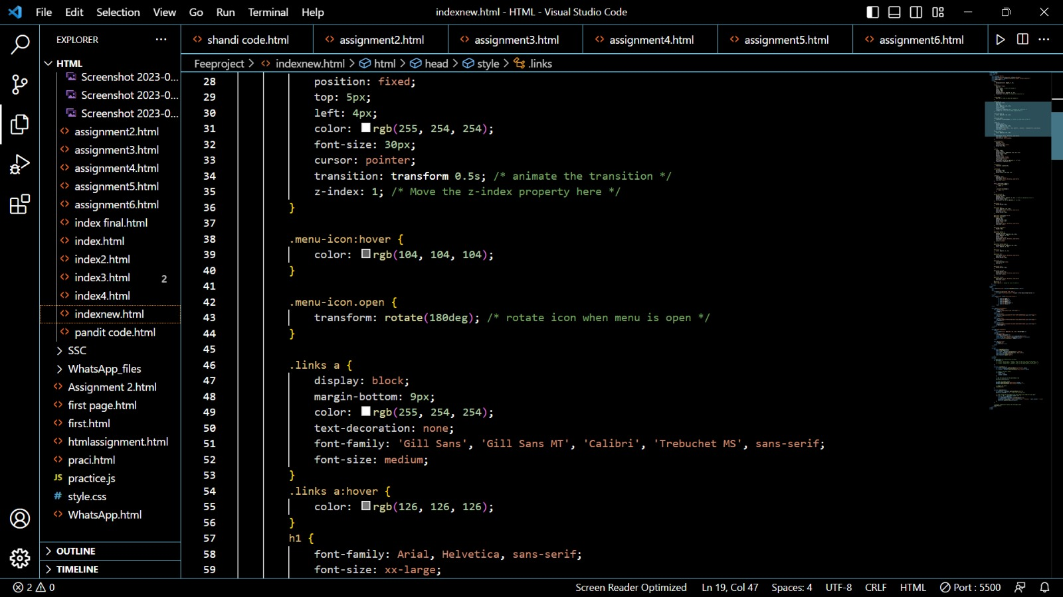
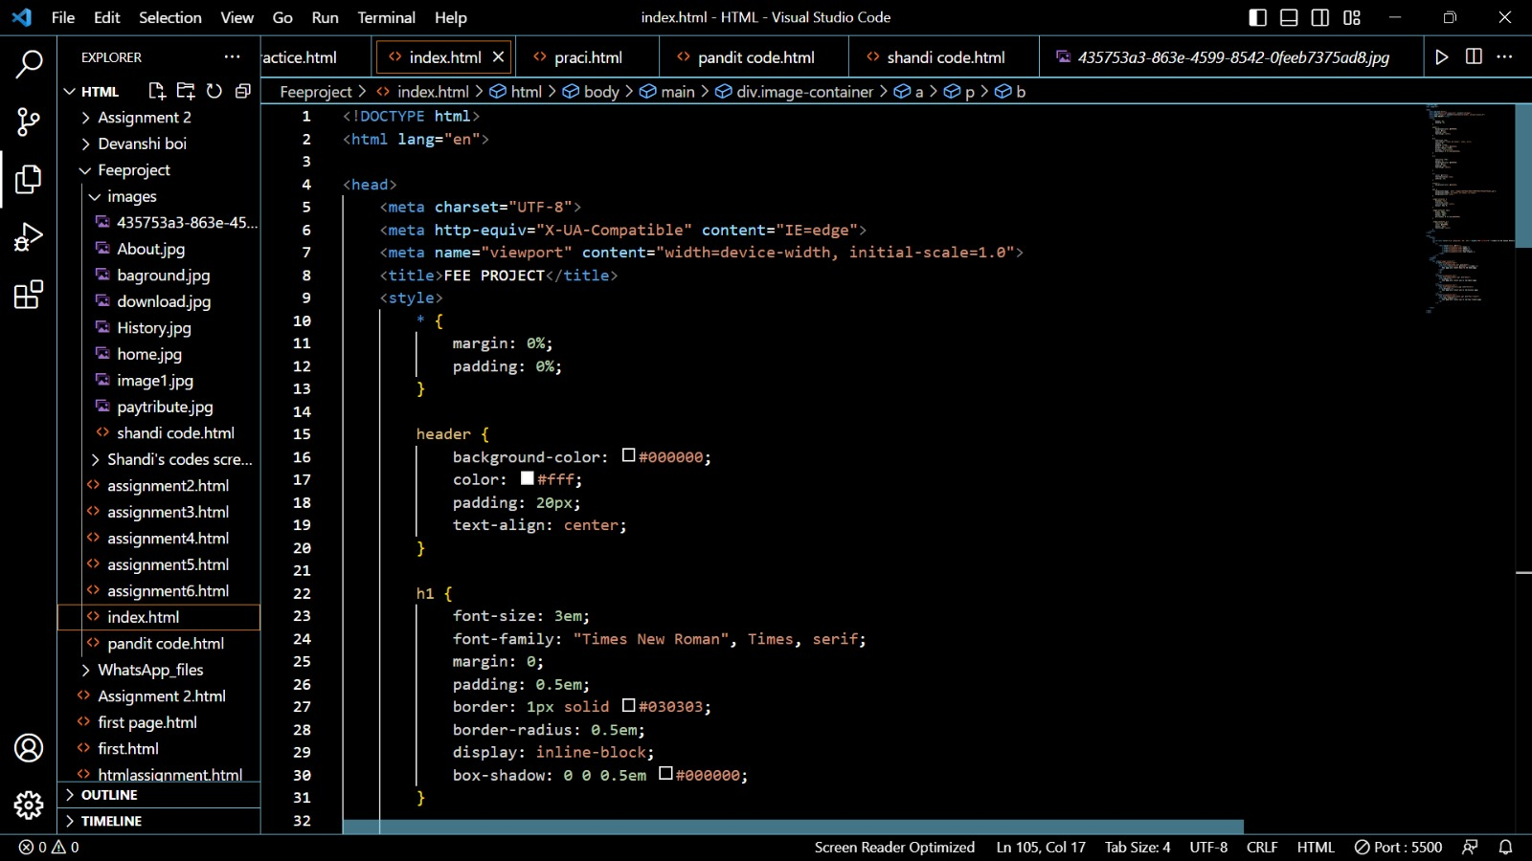
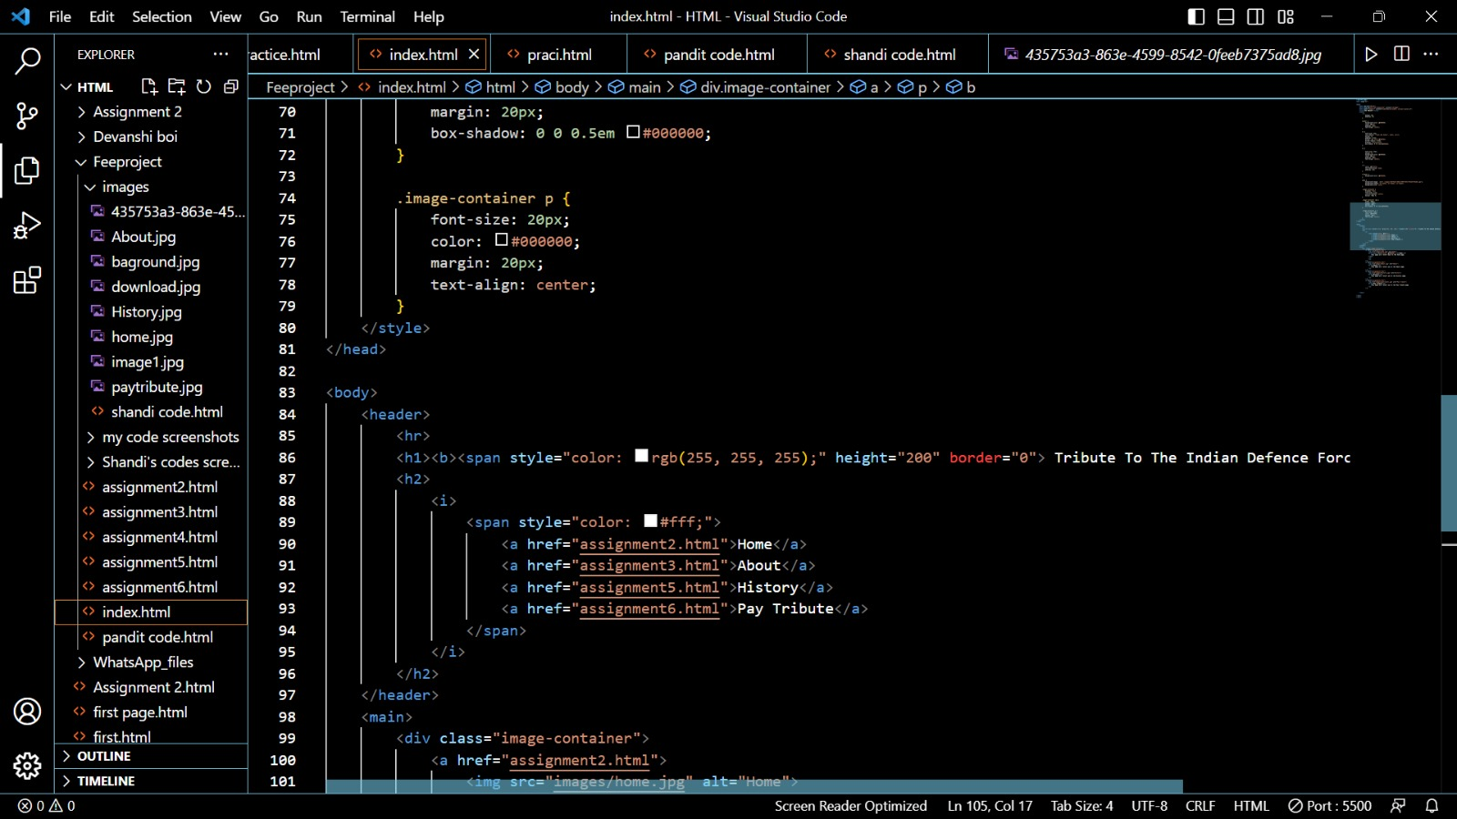
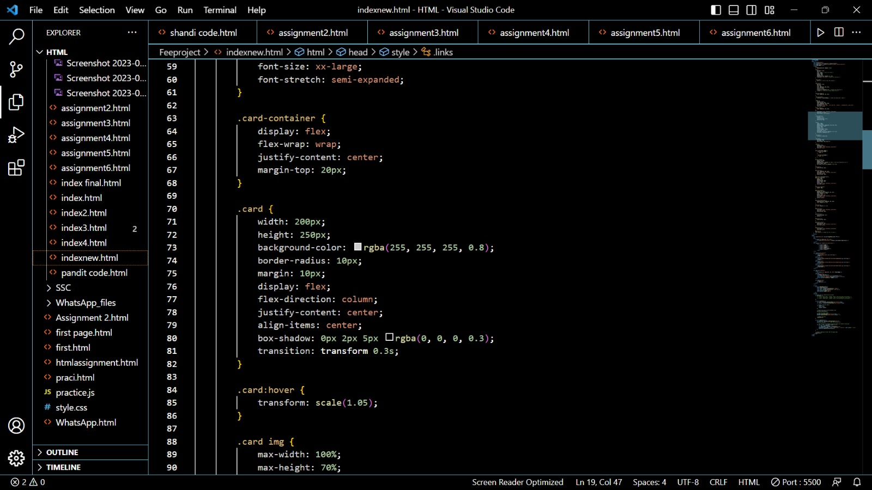
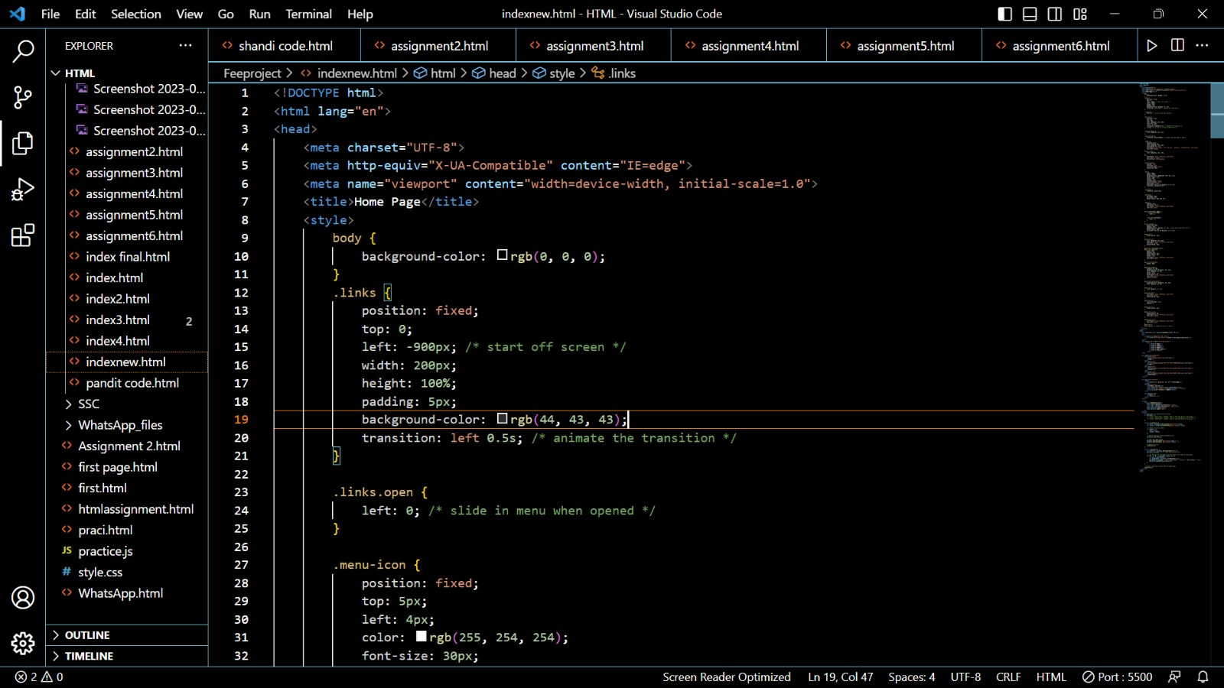
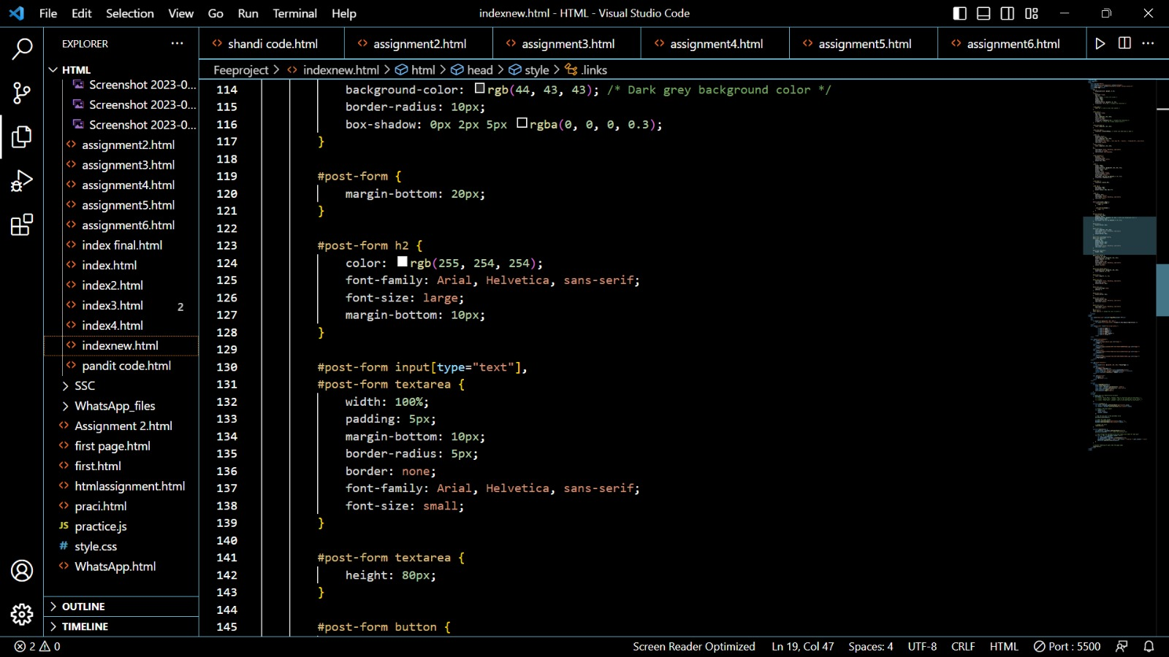
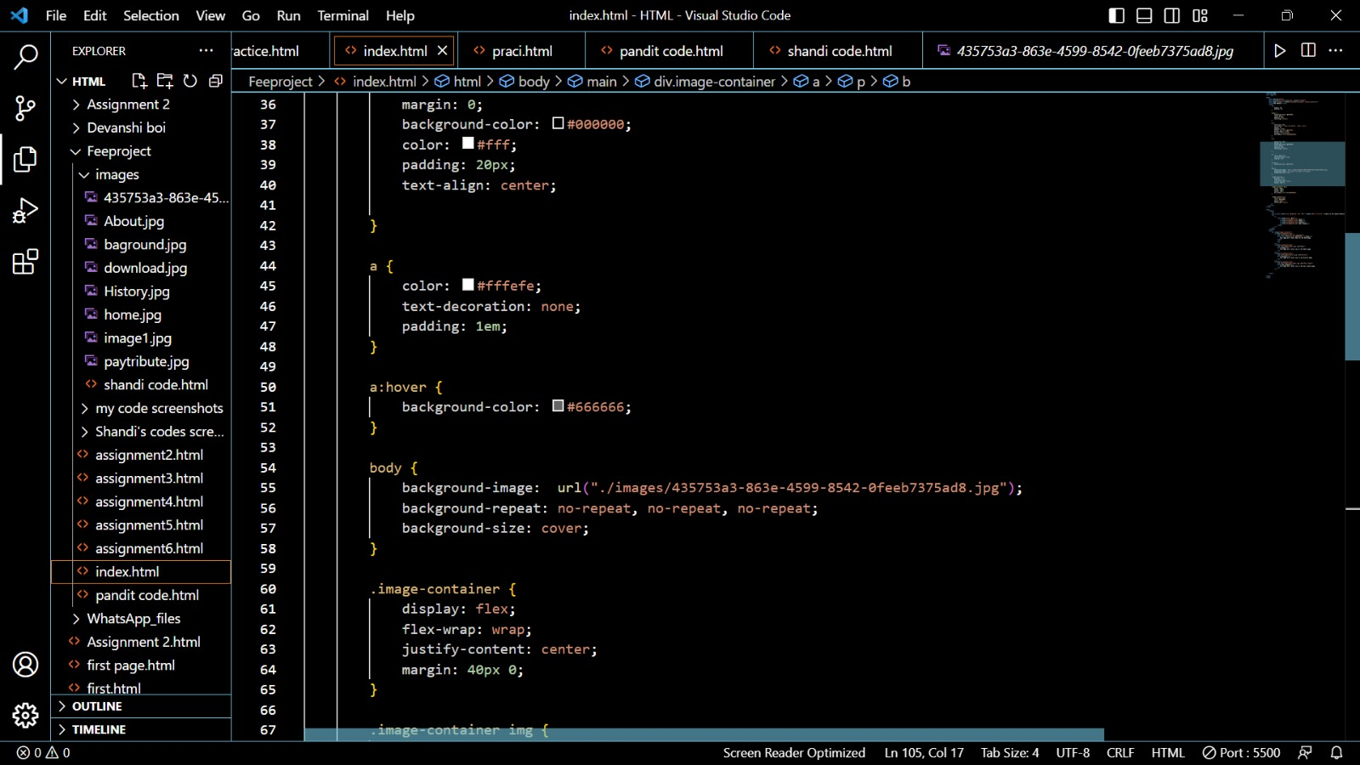
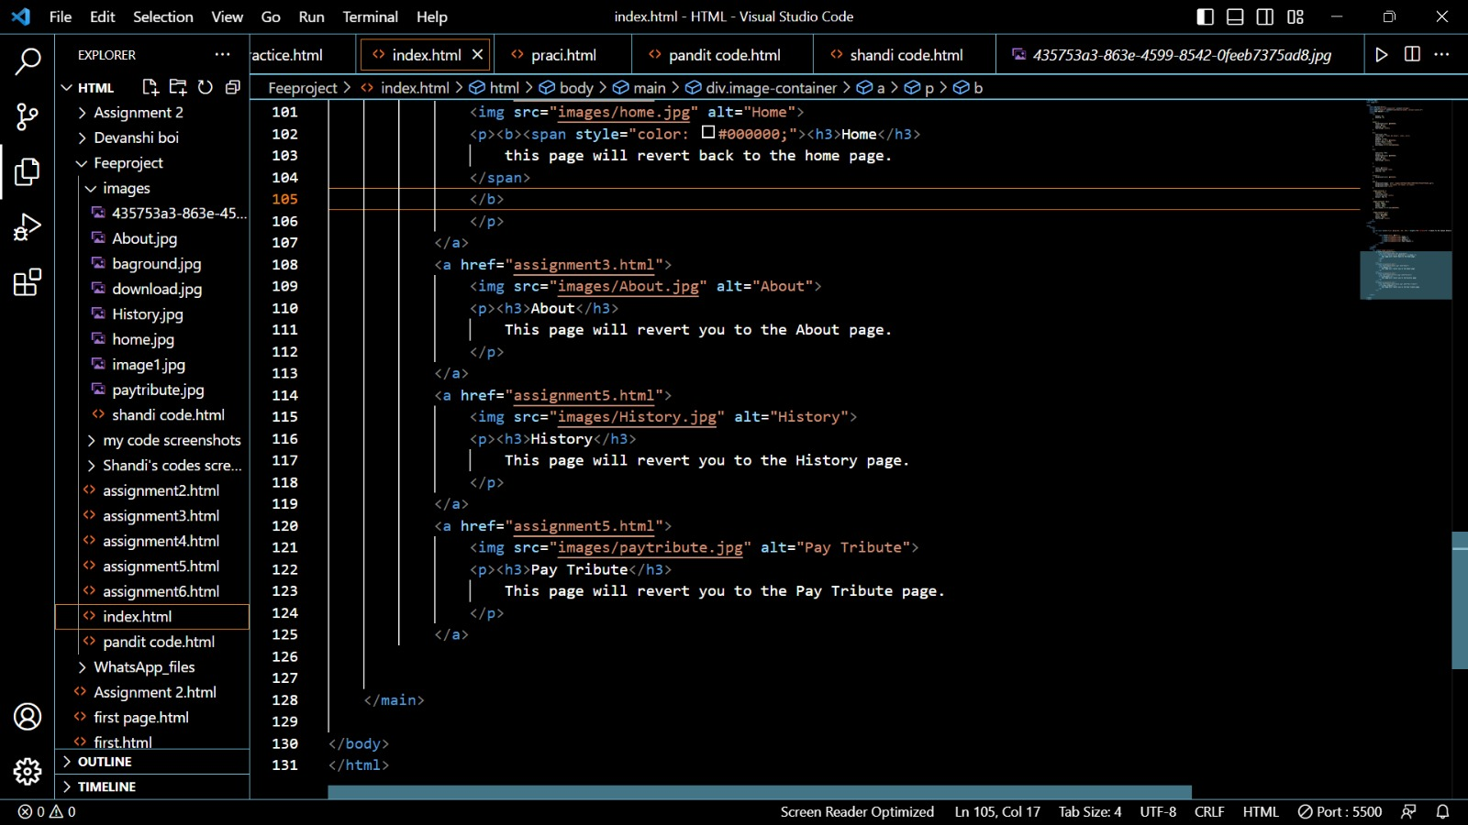
Project Highlights
HTML/CSS/JavaScript code snippets for Home Page:

Slide 8
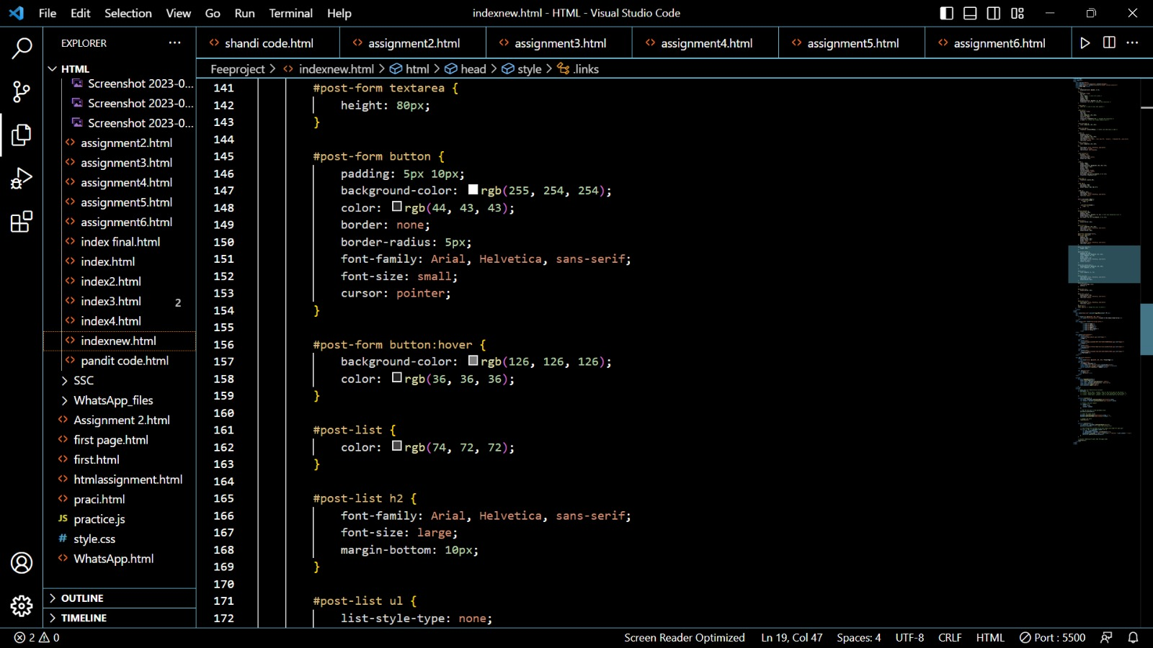
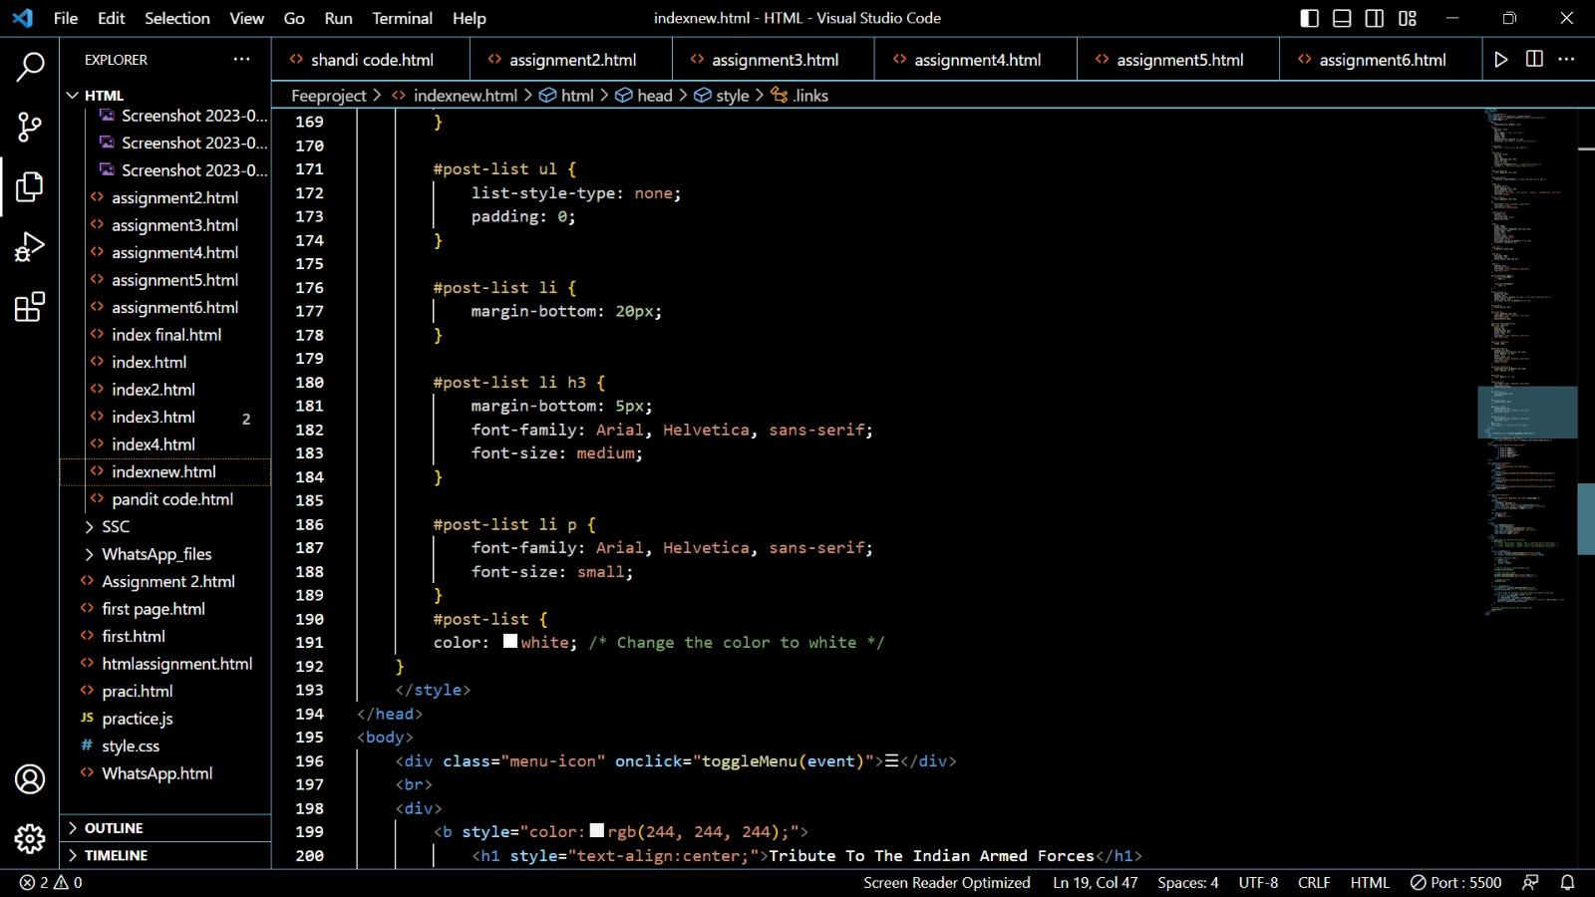
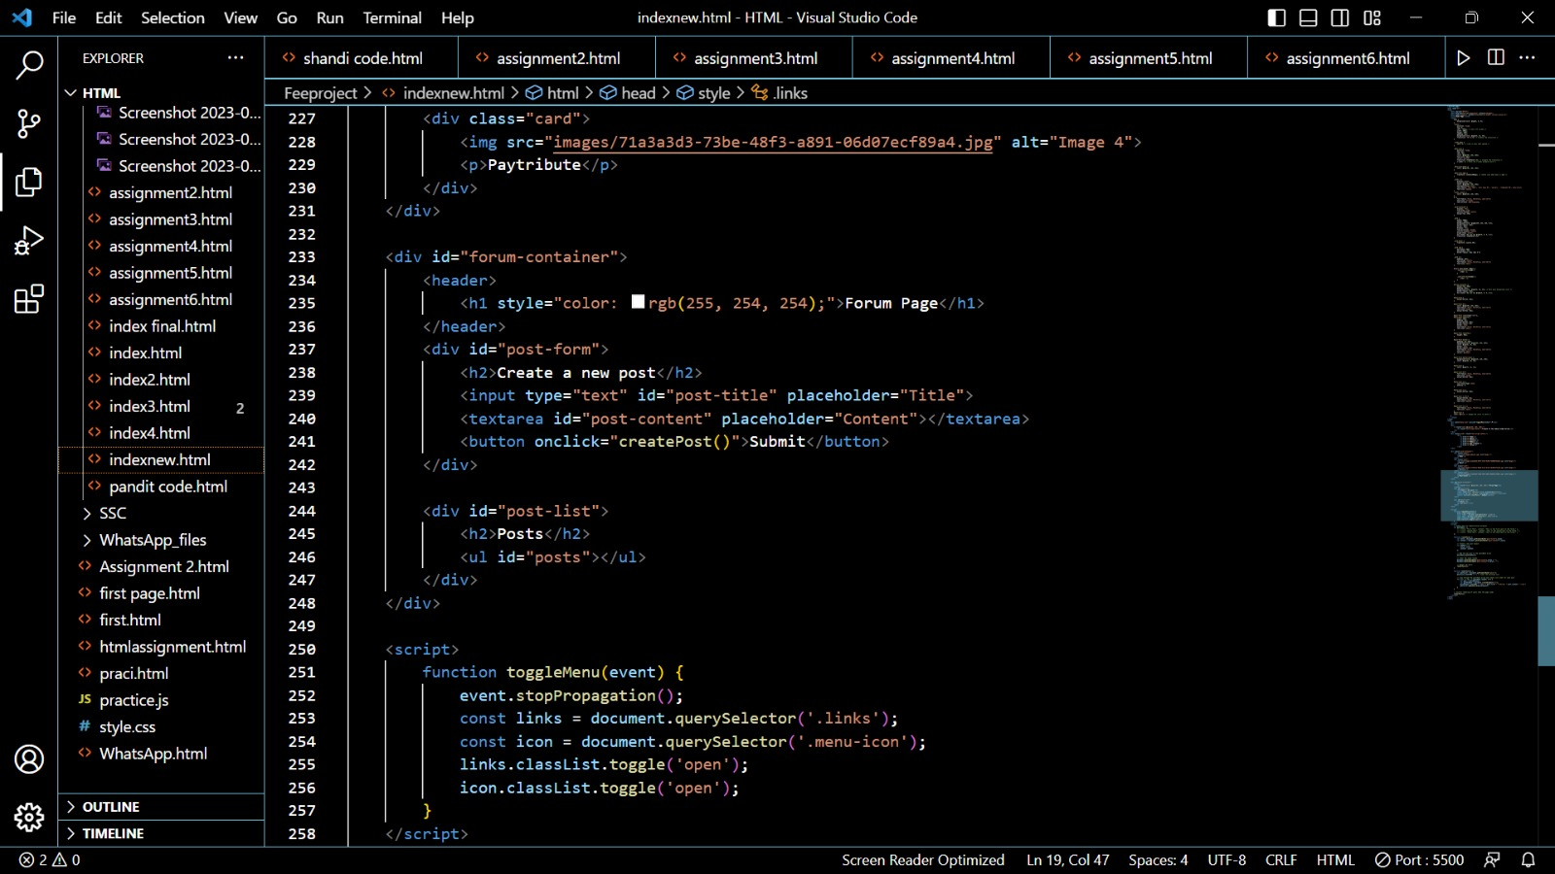
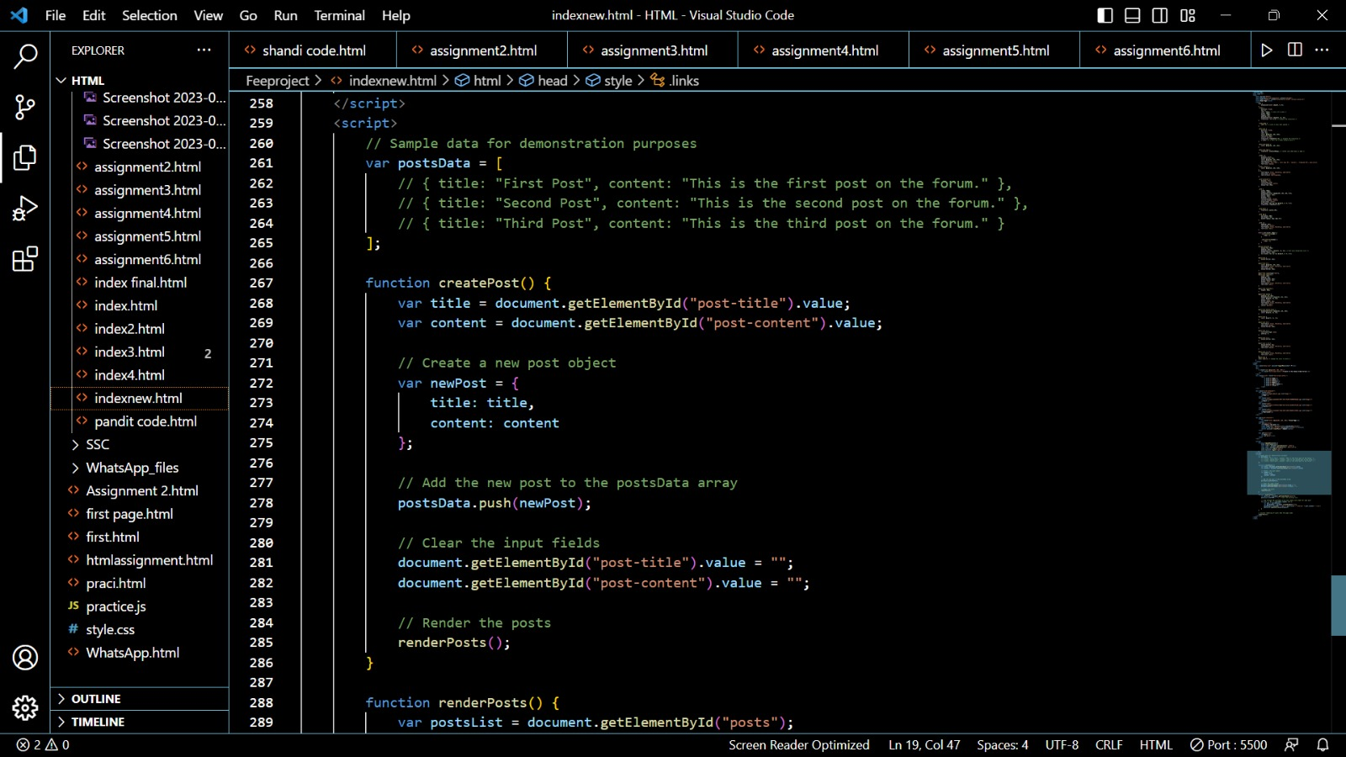

Slide 9
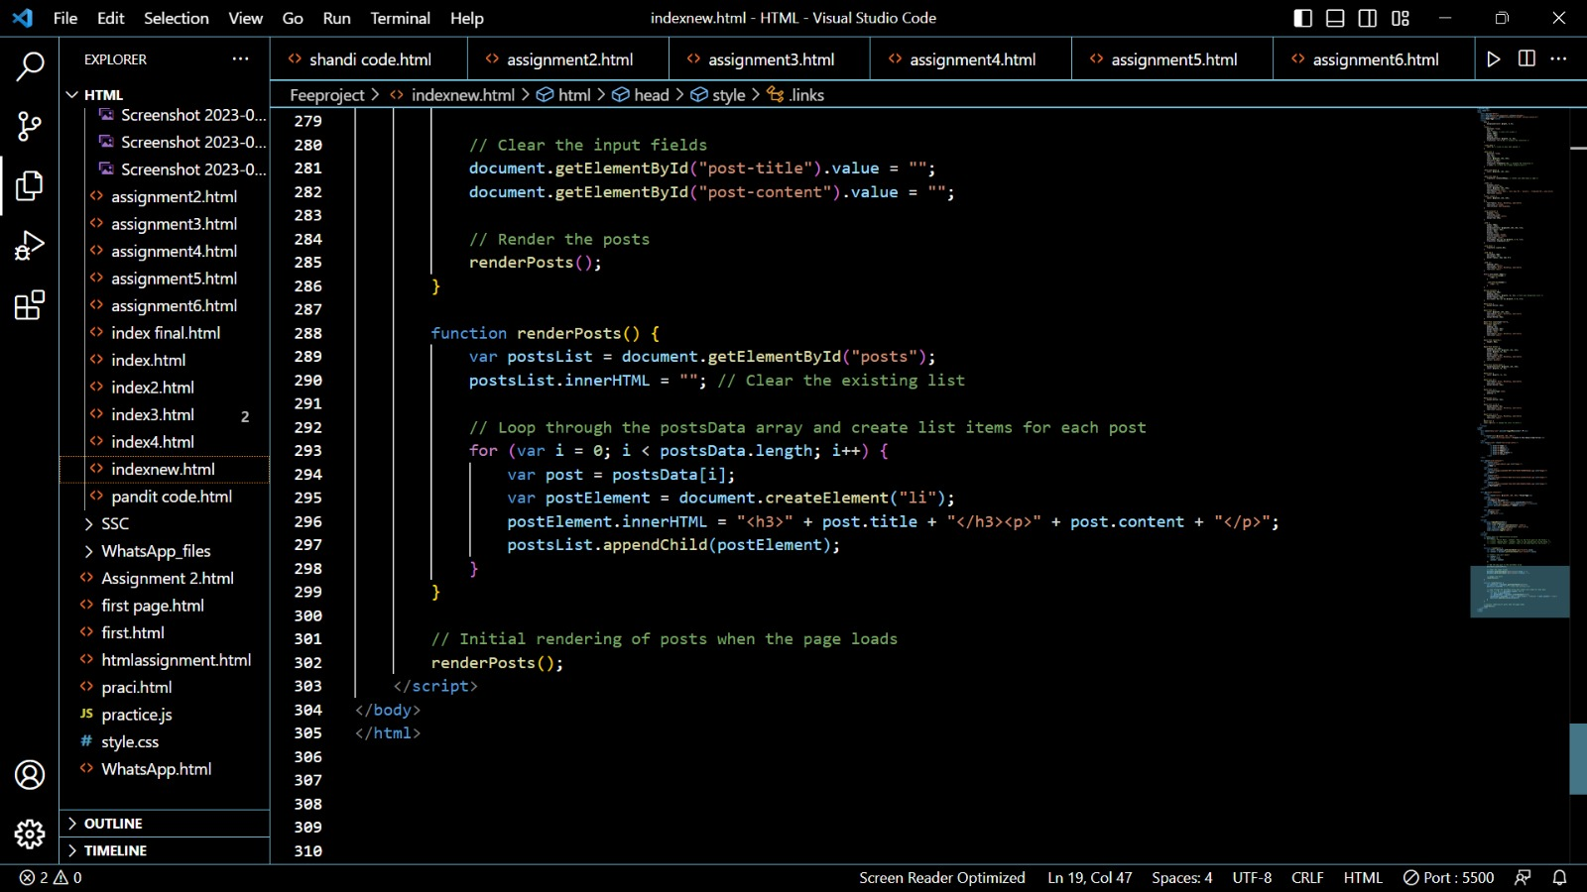

Slide 10
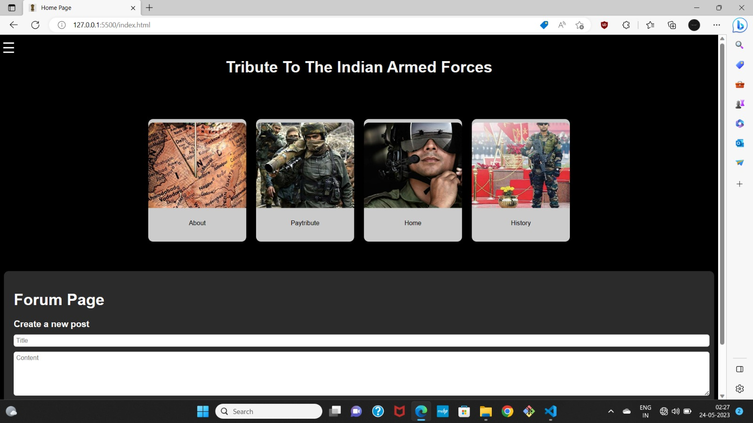
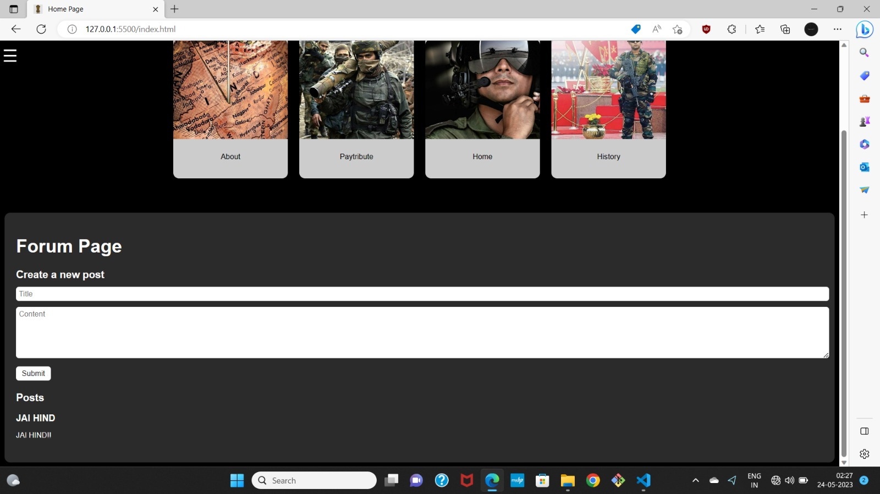
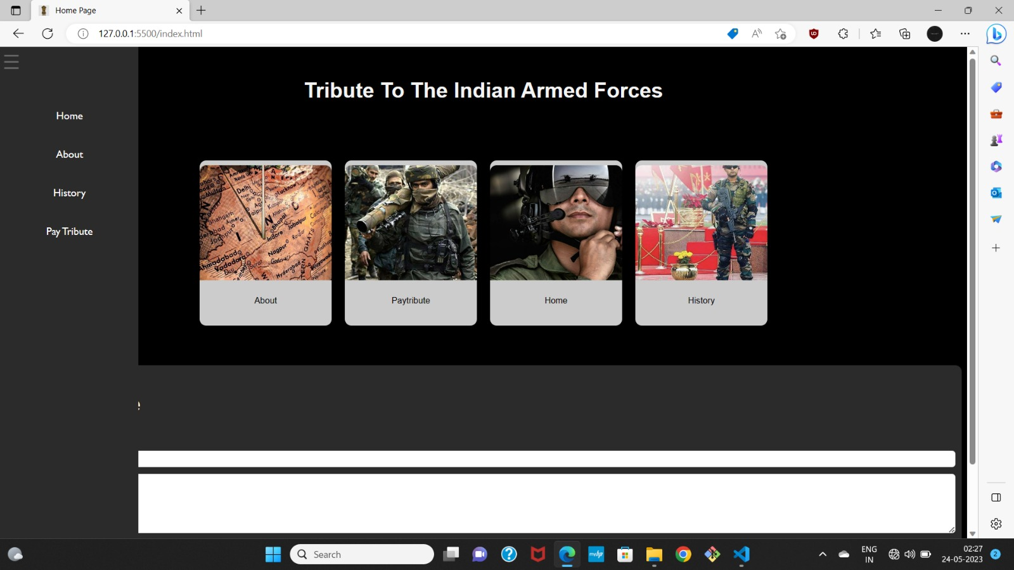
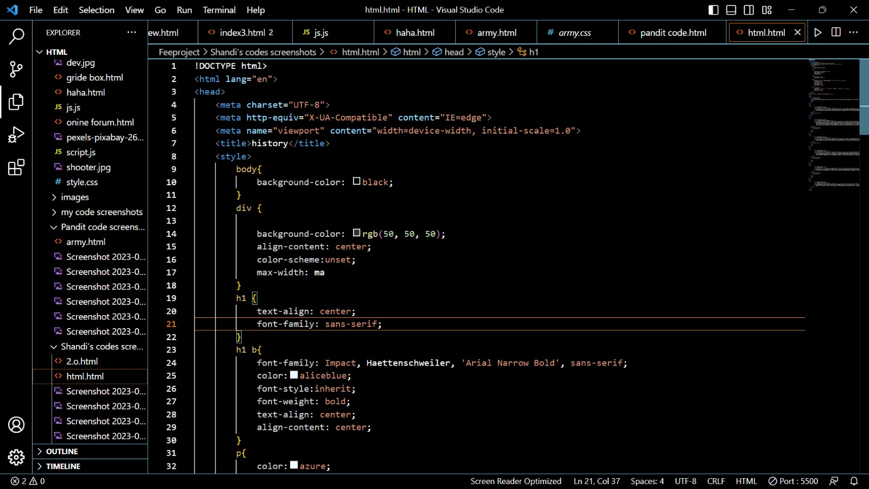
Output(Home Page) of the code snippets:

Slide 11
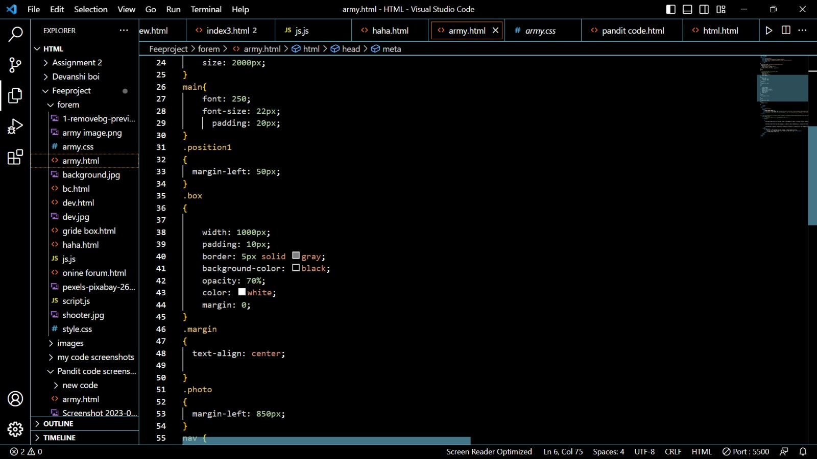
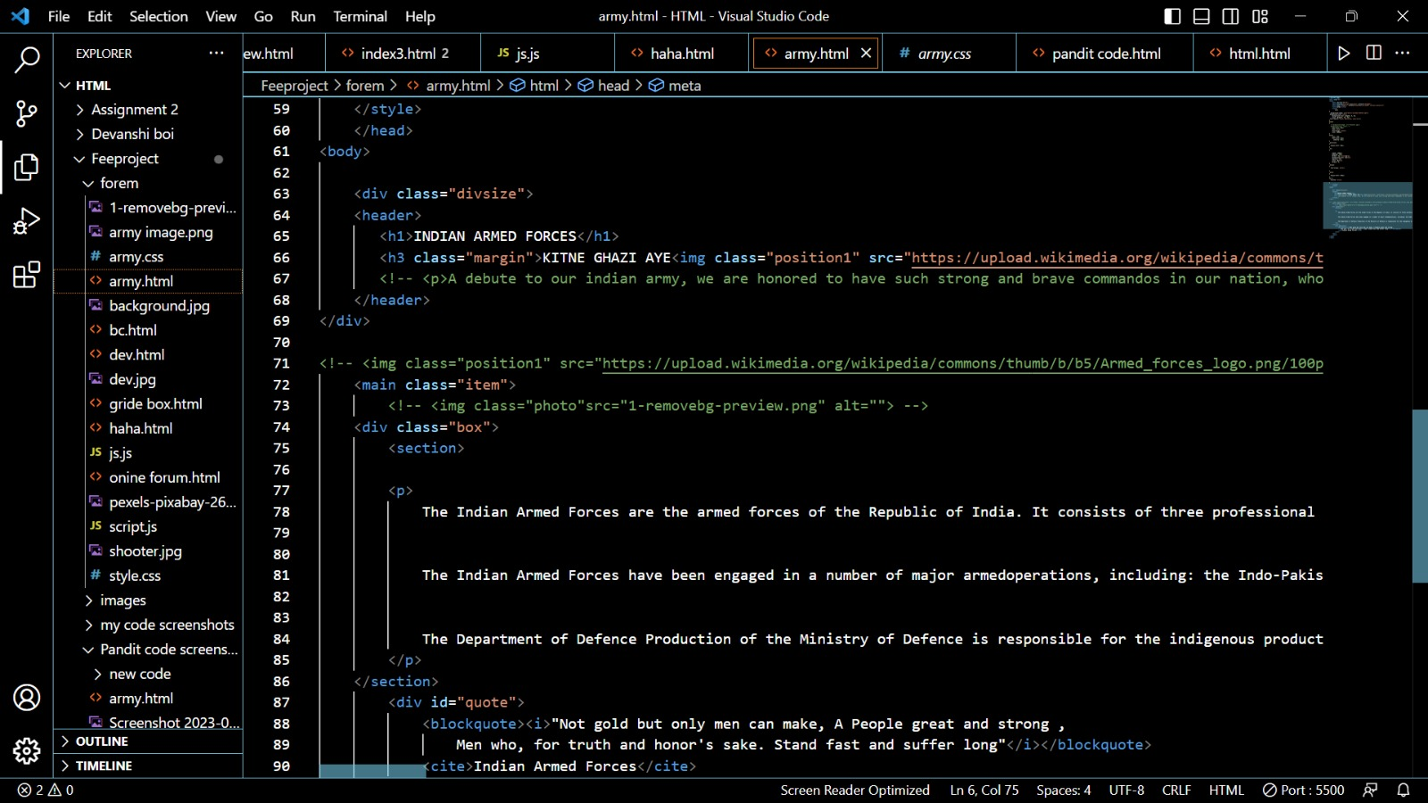
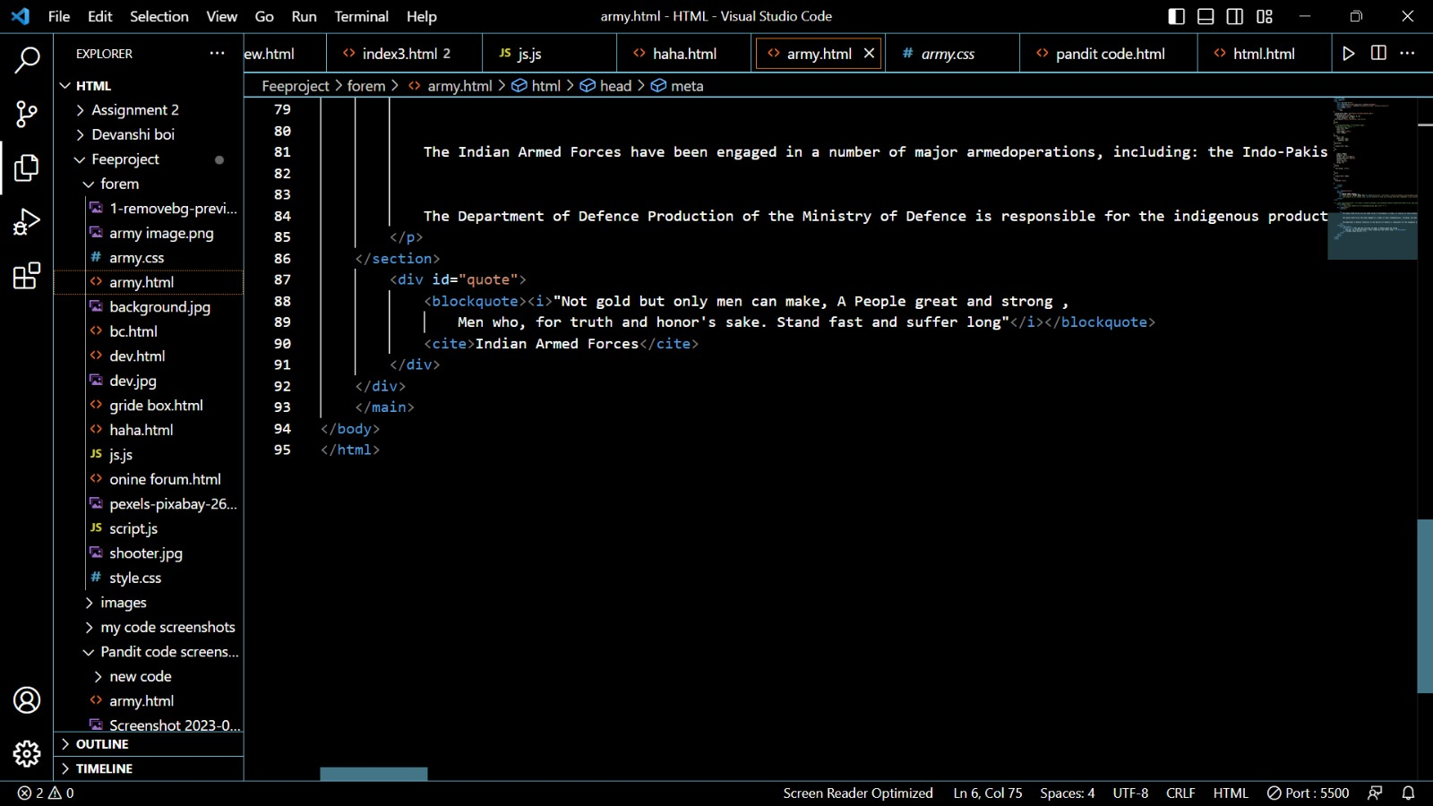
HTML/CSS code snippets for About Page:

Slide 12
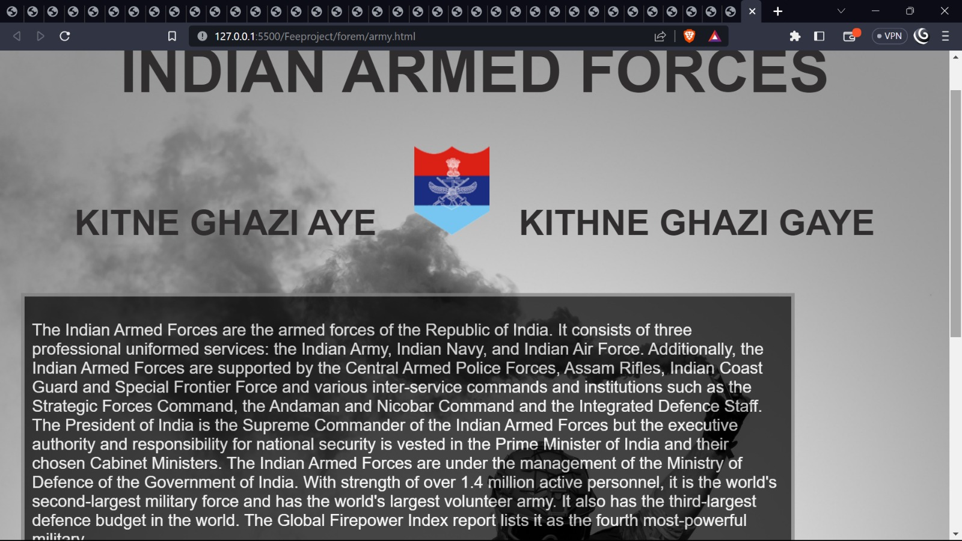
Output(About Page) of the code snippets:

Slide 13
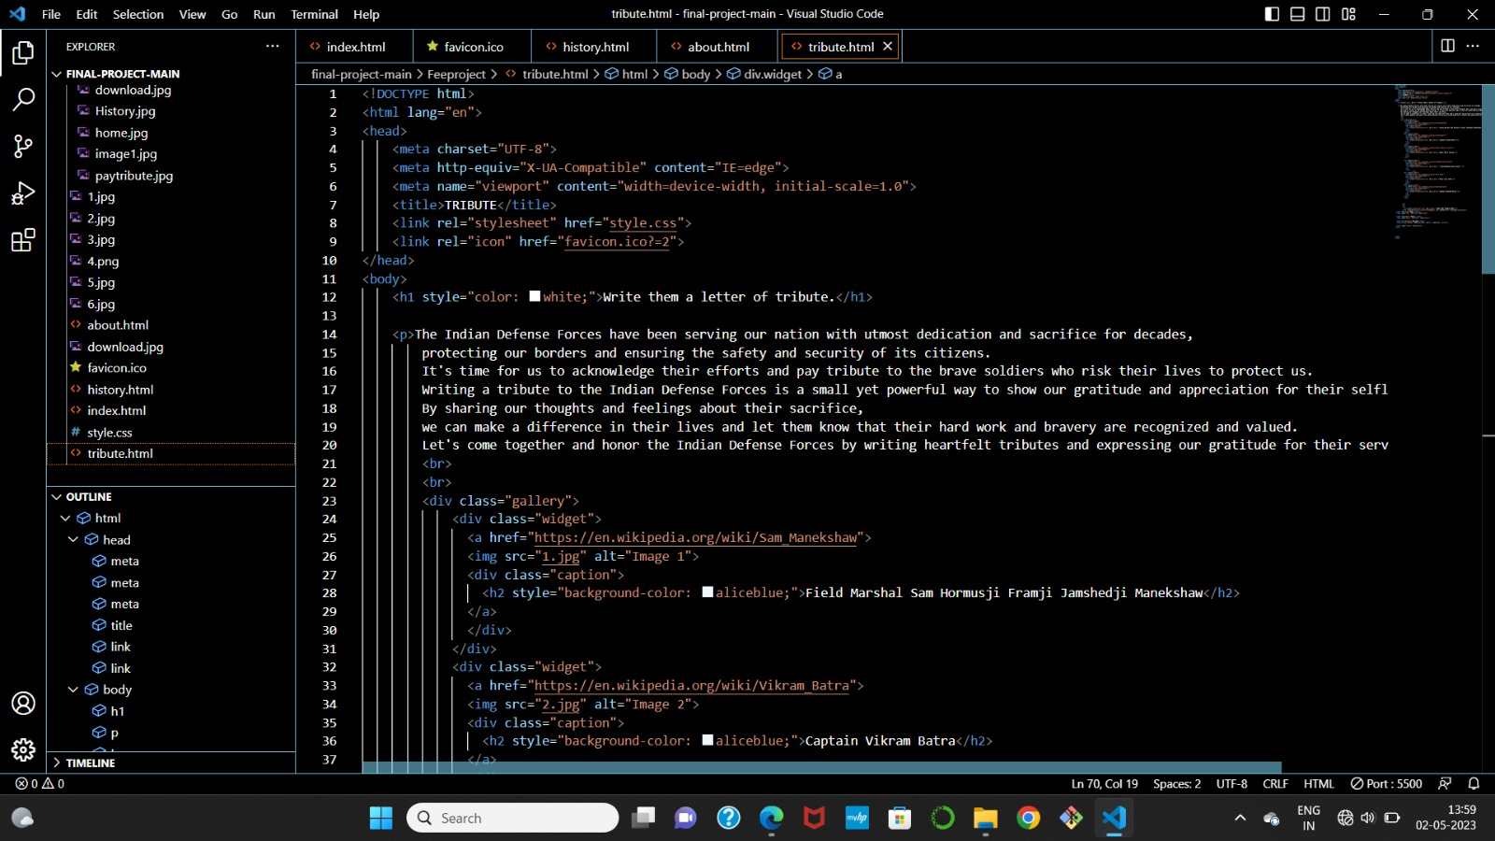
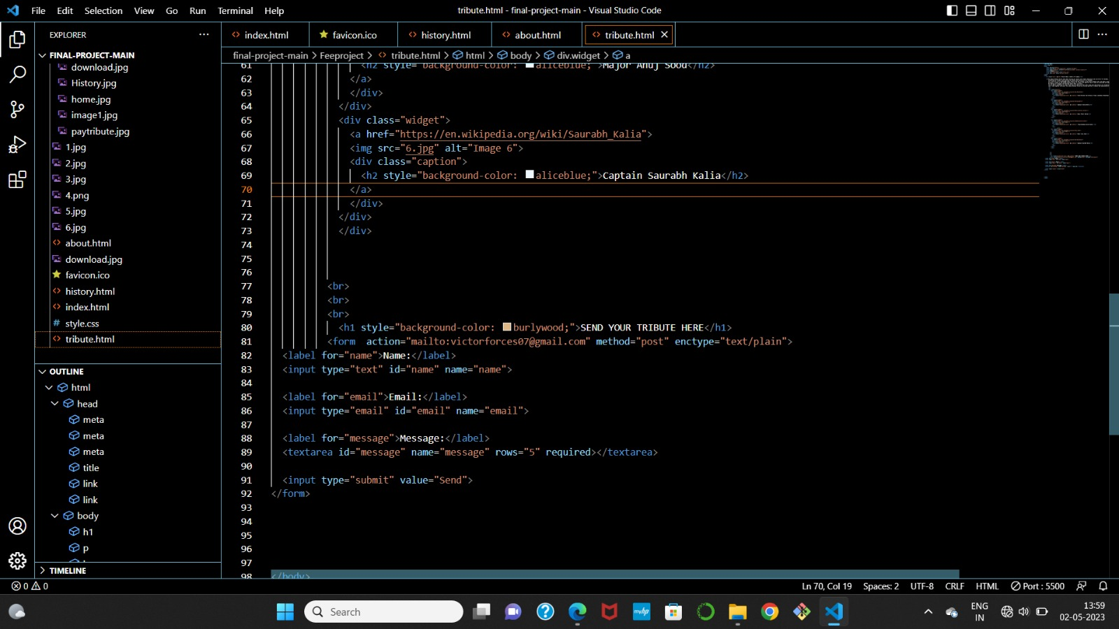
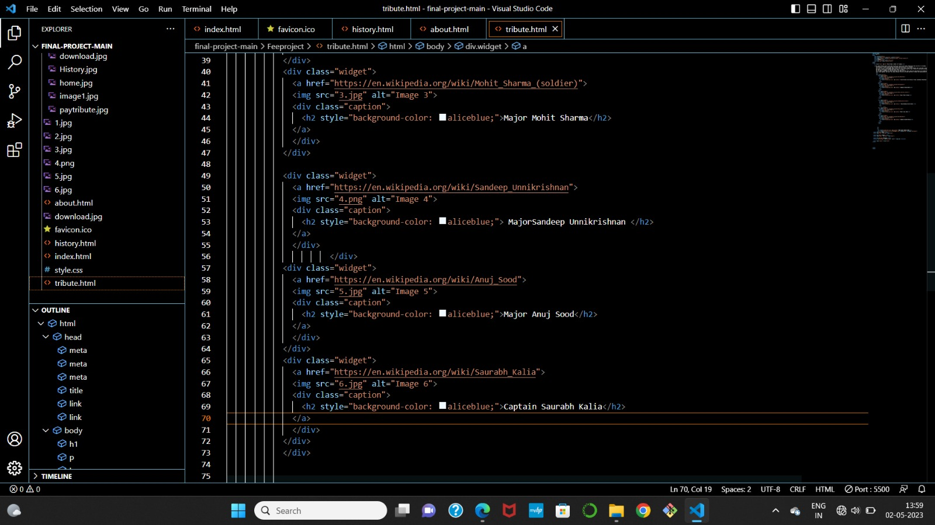
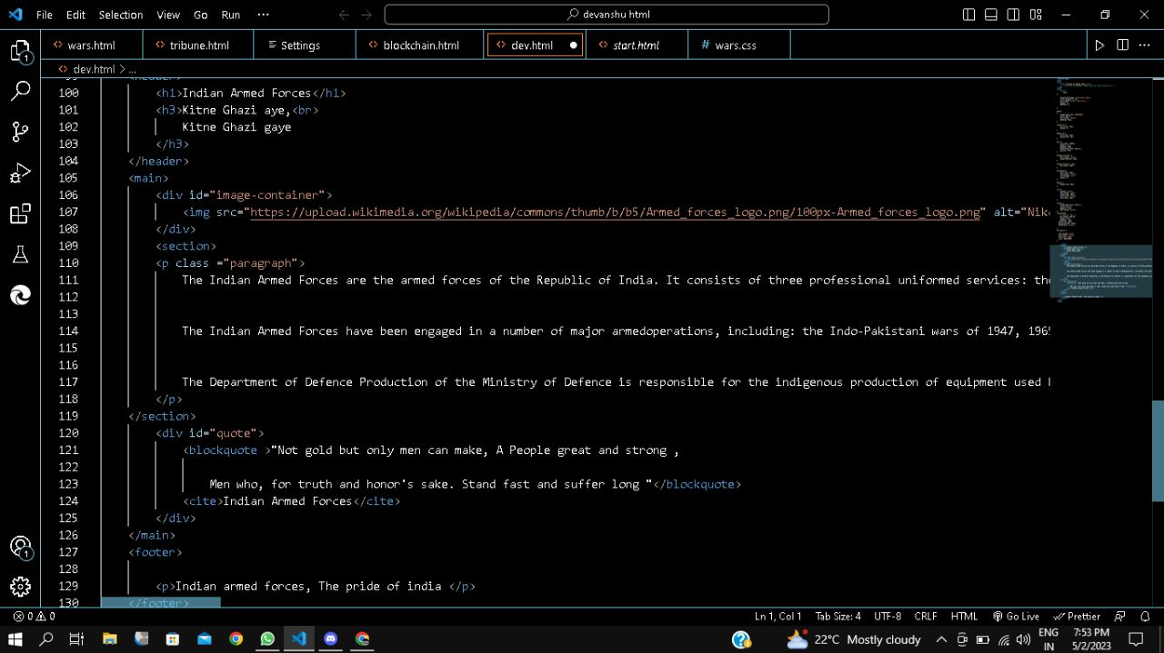
HTML/CSS code snippets for Pay Tribute Page:

Slide 14
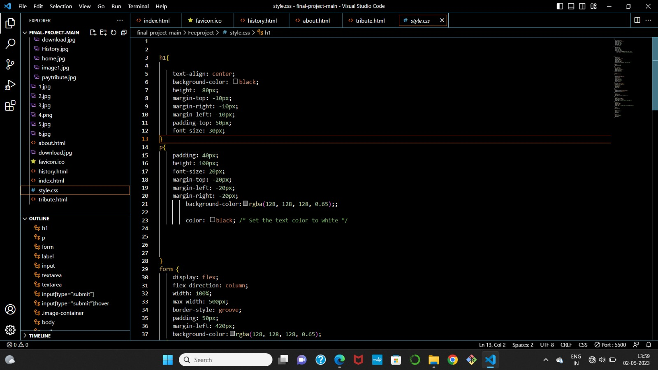
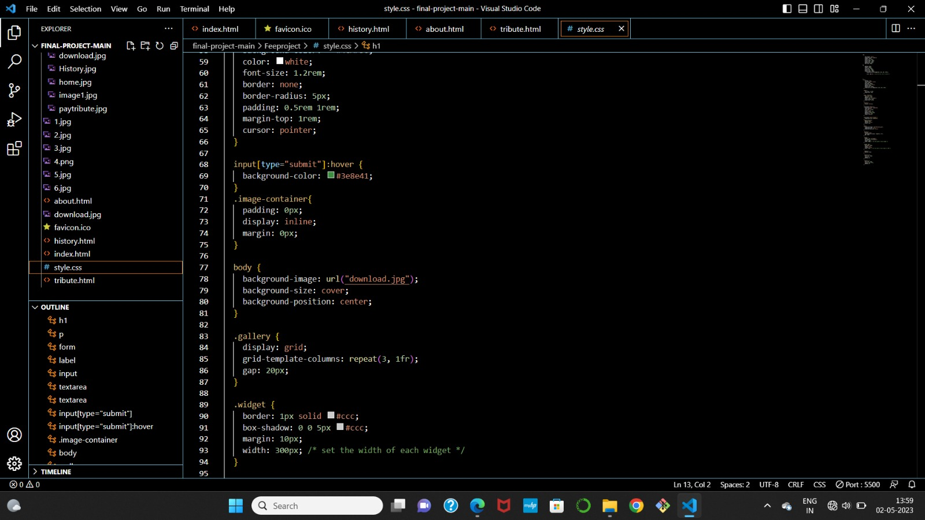
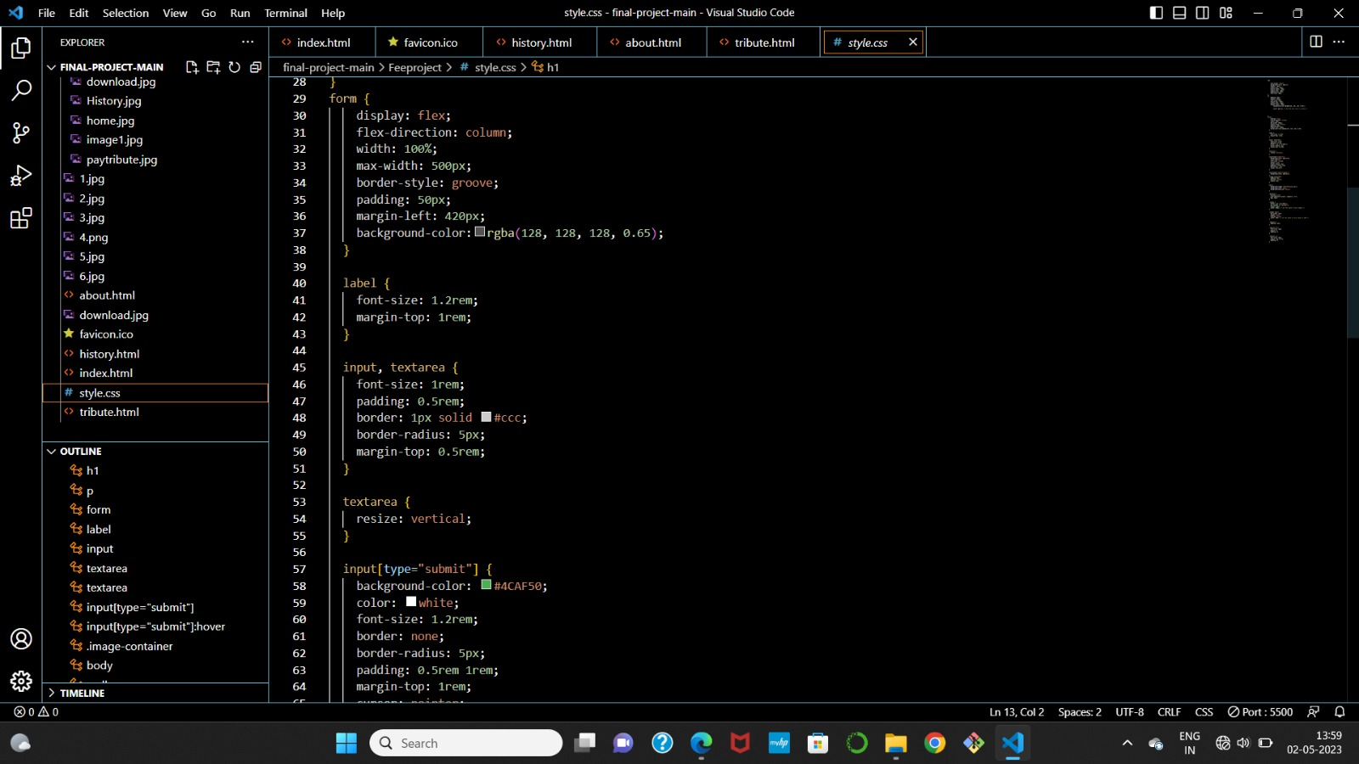
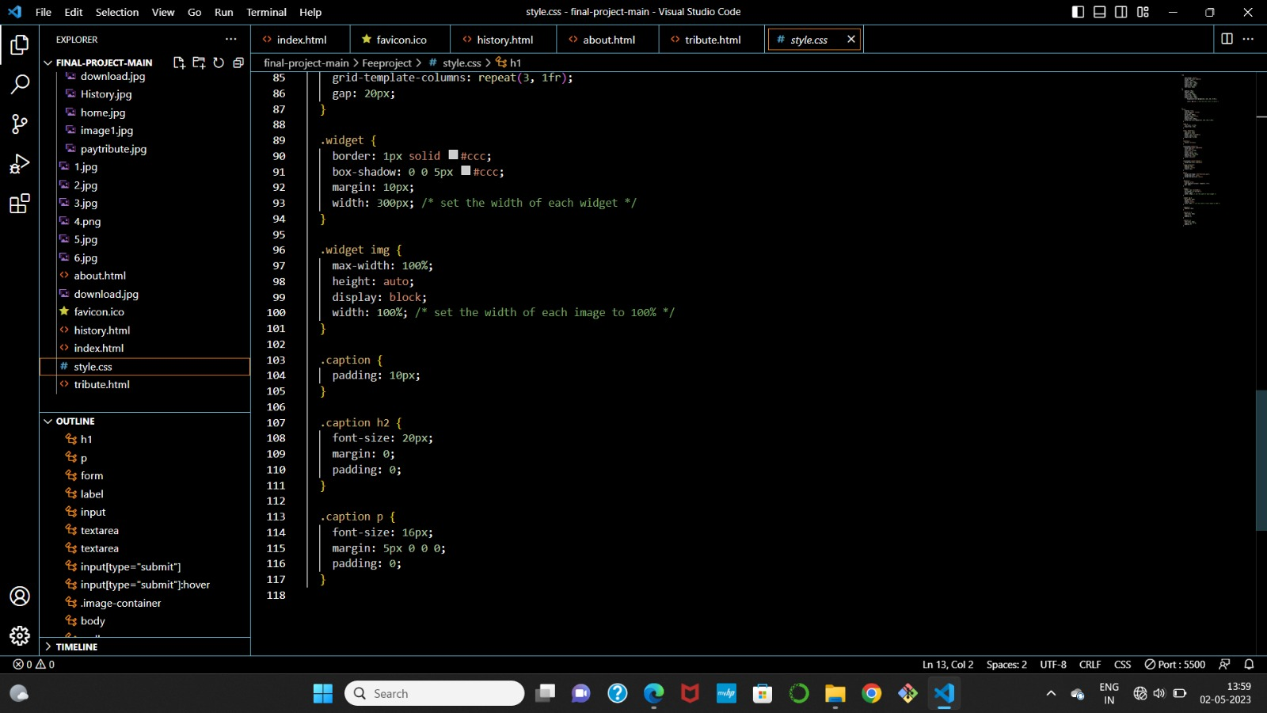

Slide 15
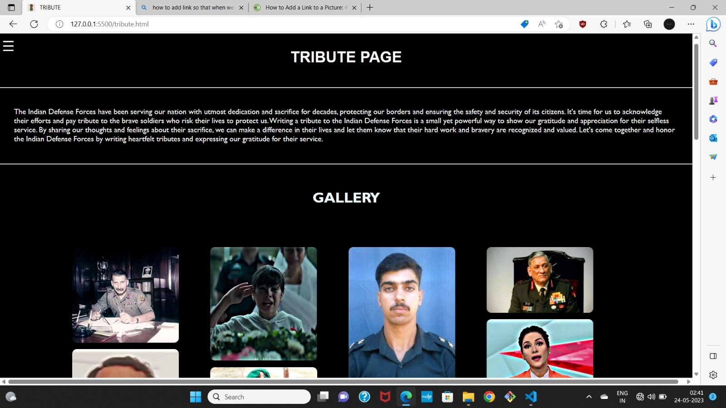
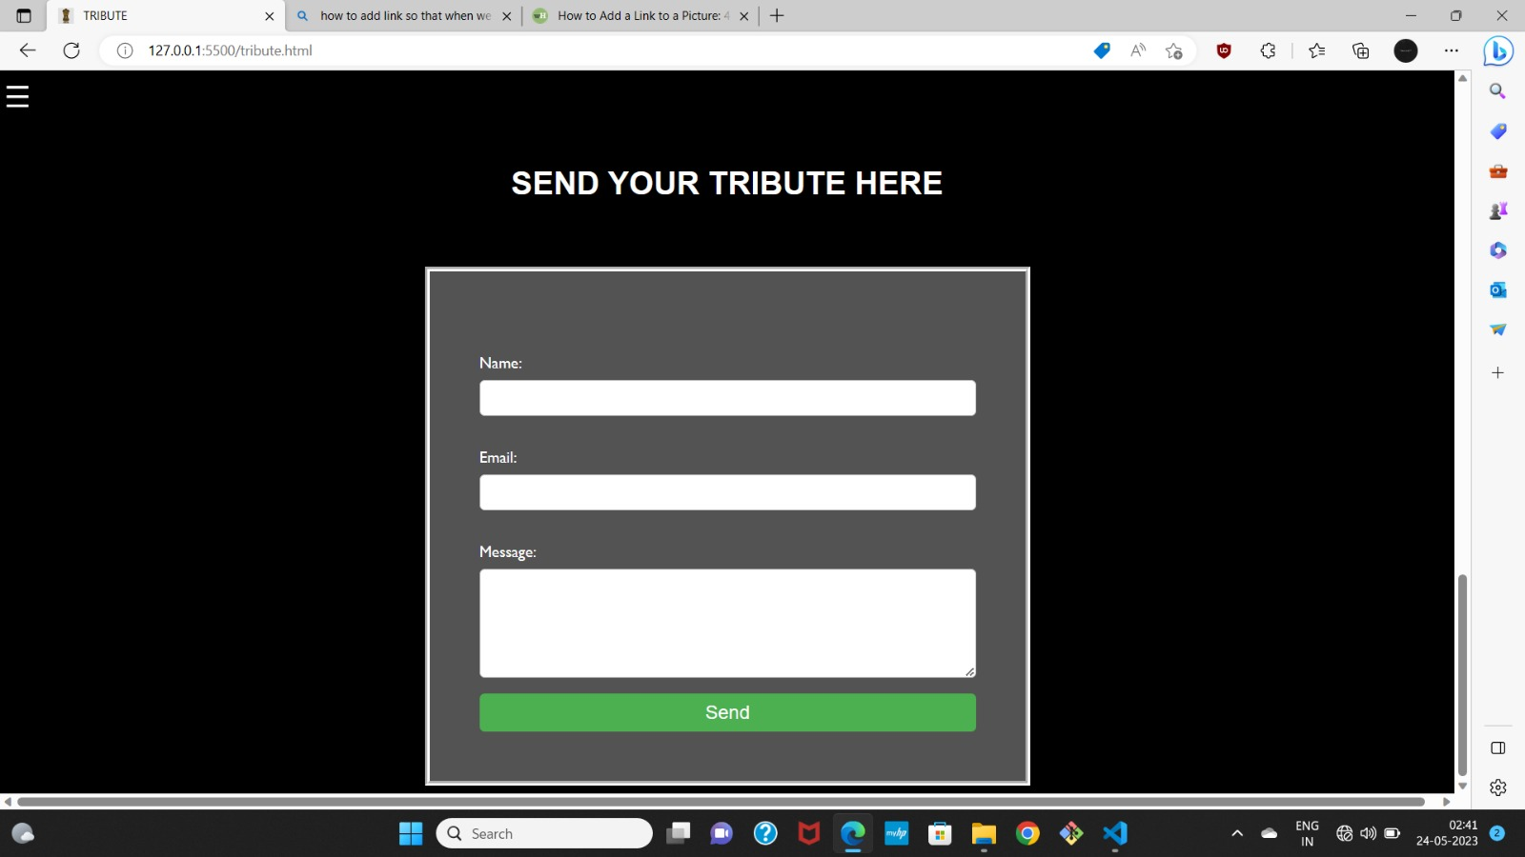
Output(Pay Tribute Page) of the code snippets:

Slide 16
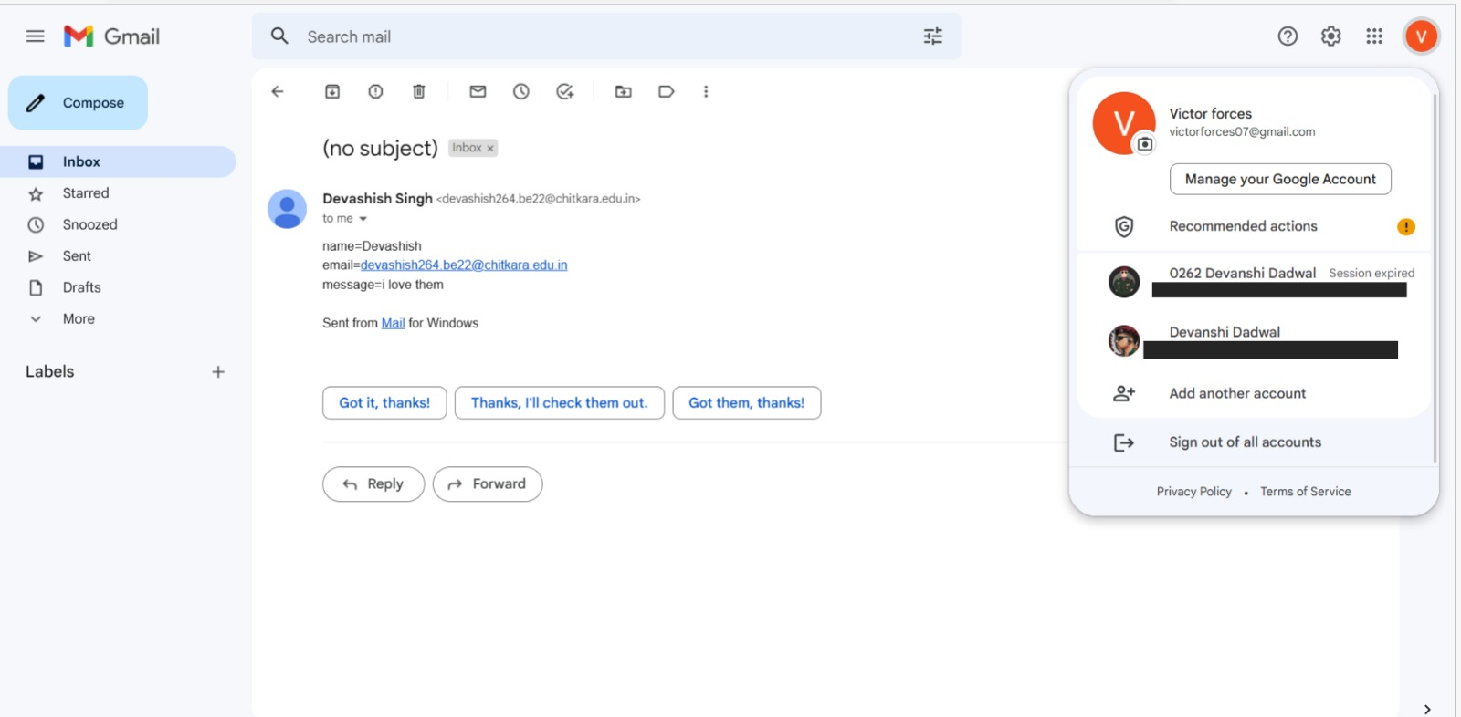
Sending the tribute message allows the written message to be received by us and is shown to us similar to the above image.

Slide 17
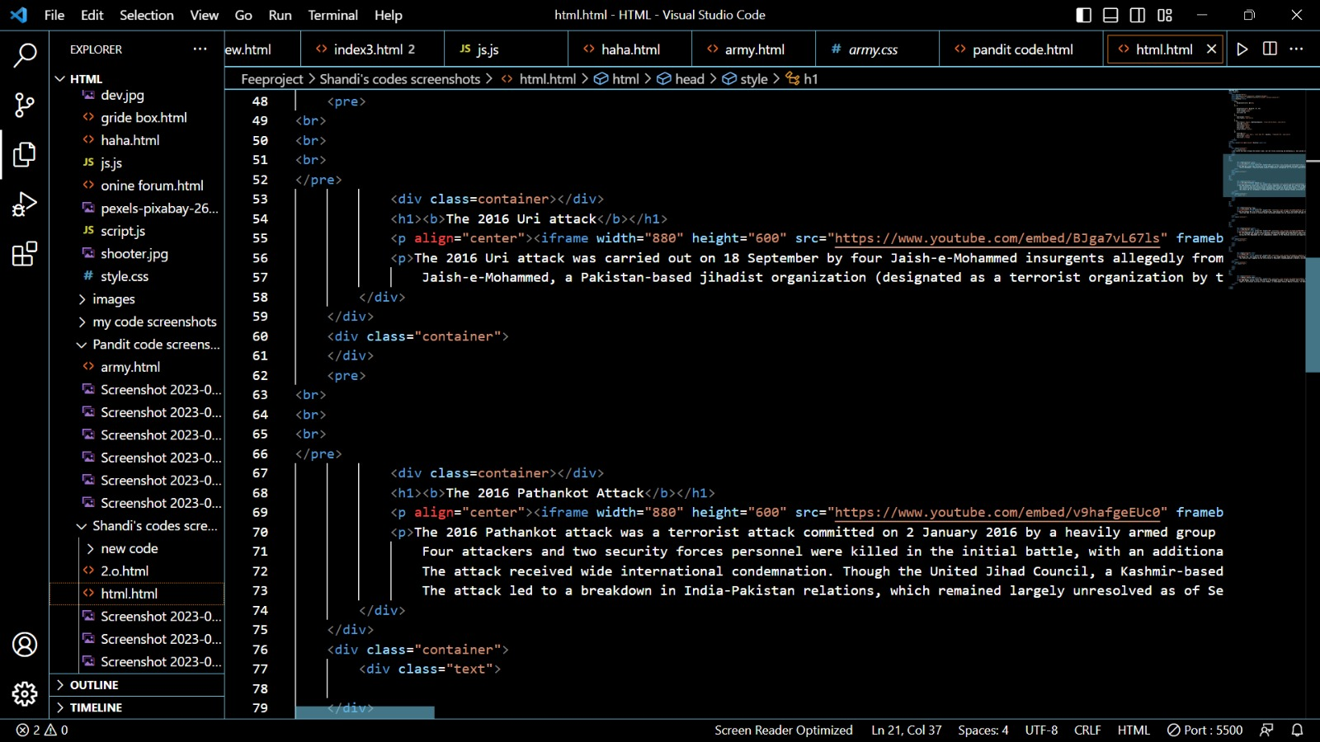
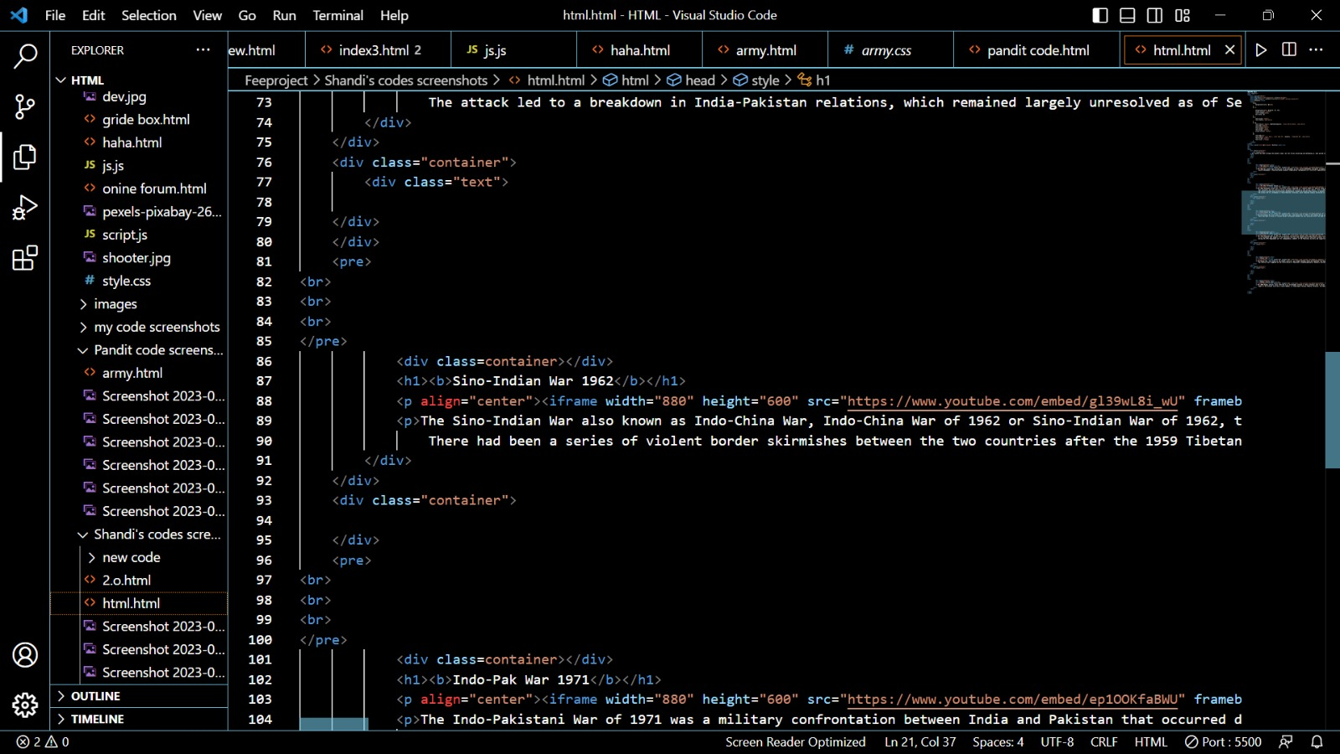
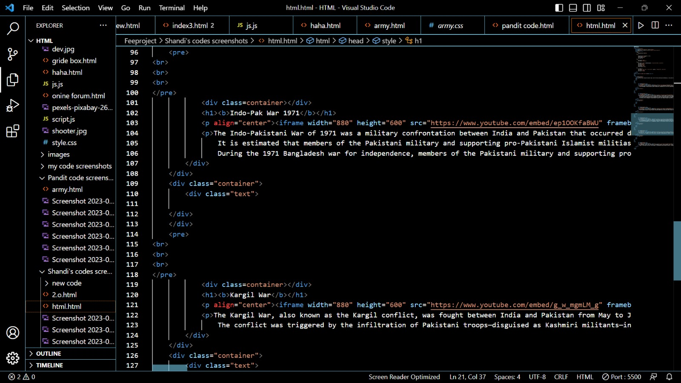
HTML/CSS code snippets for History page:

Slide 18
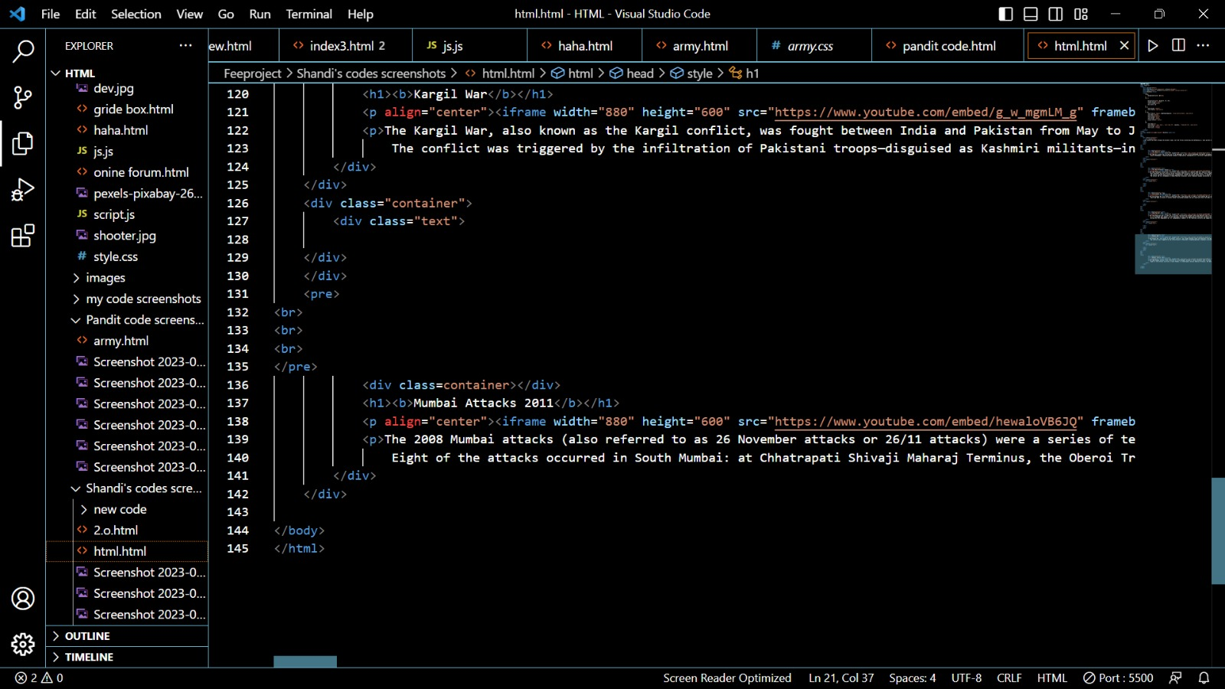

Slide 19
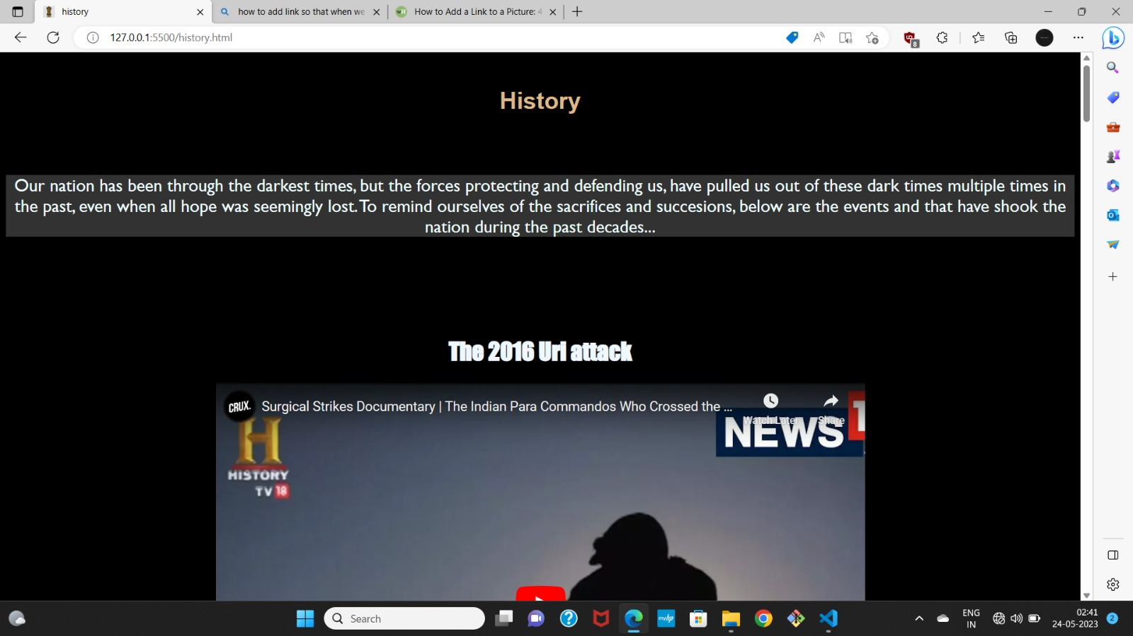
Output(History Page) of code snippets:

Slide 20
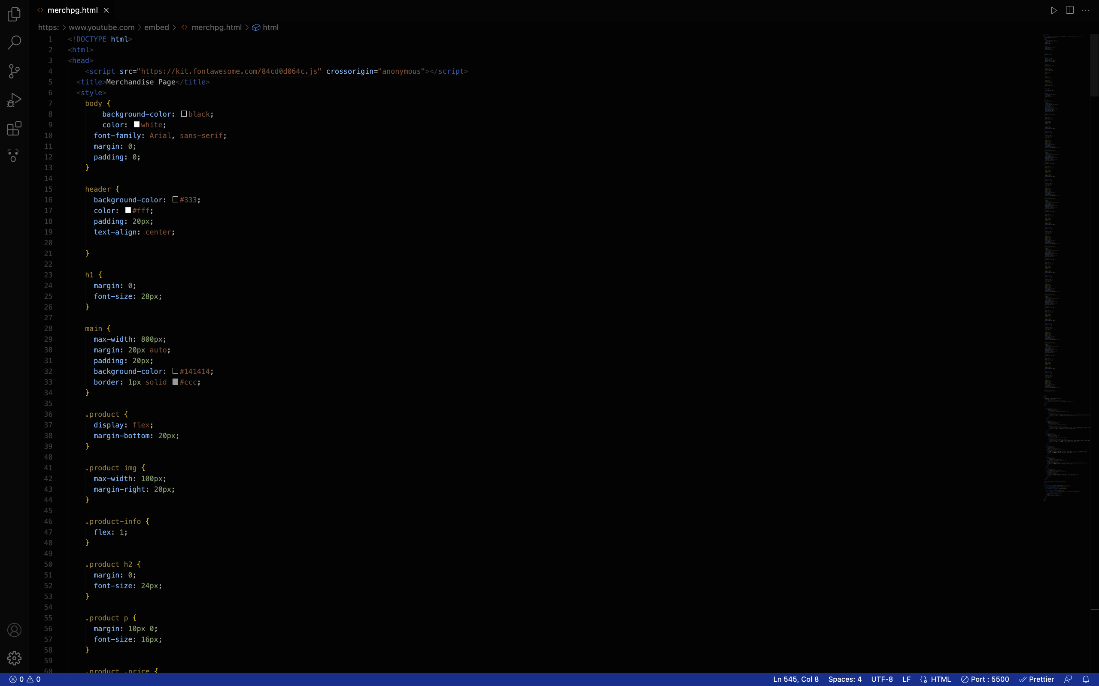
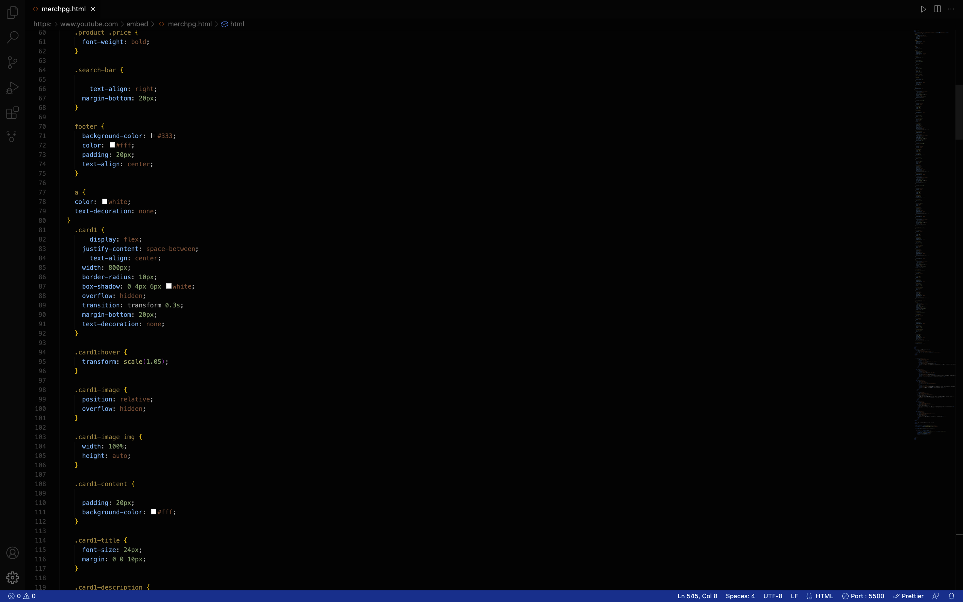
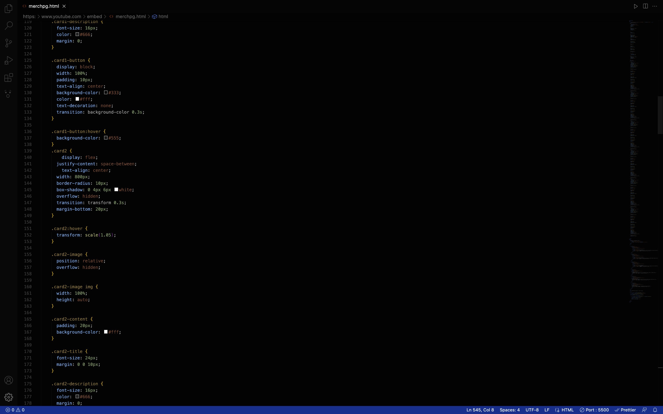
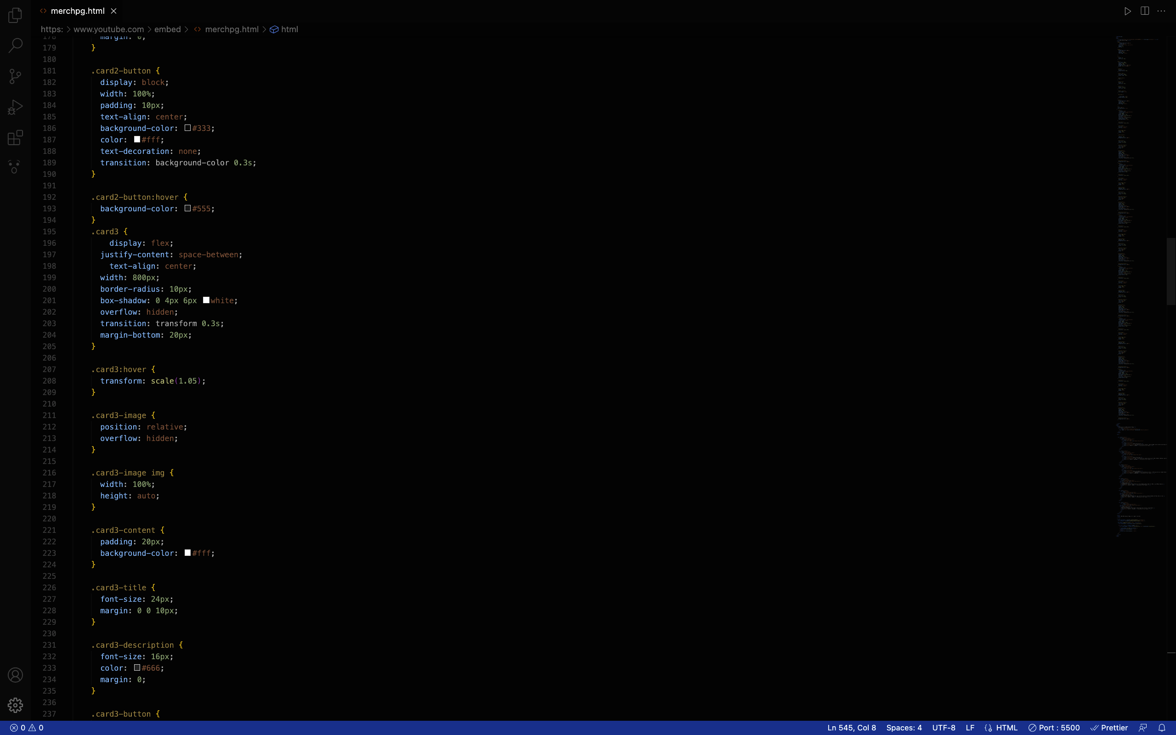
HTML/CSS/JS code snippets for Merchandise page:

Slide 21
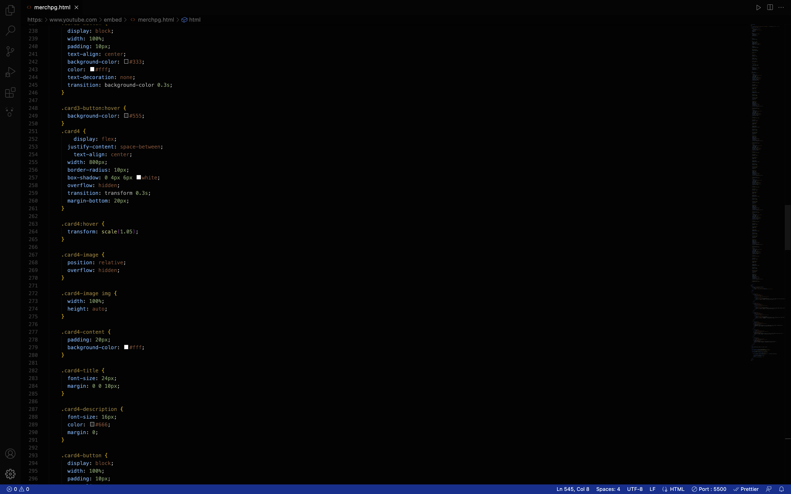
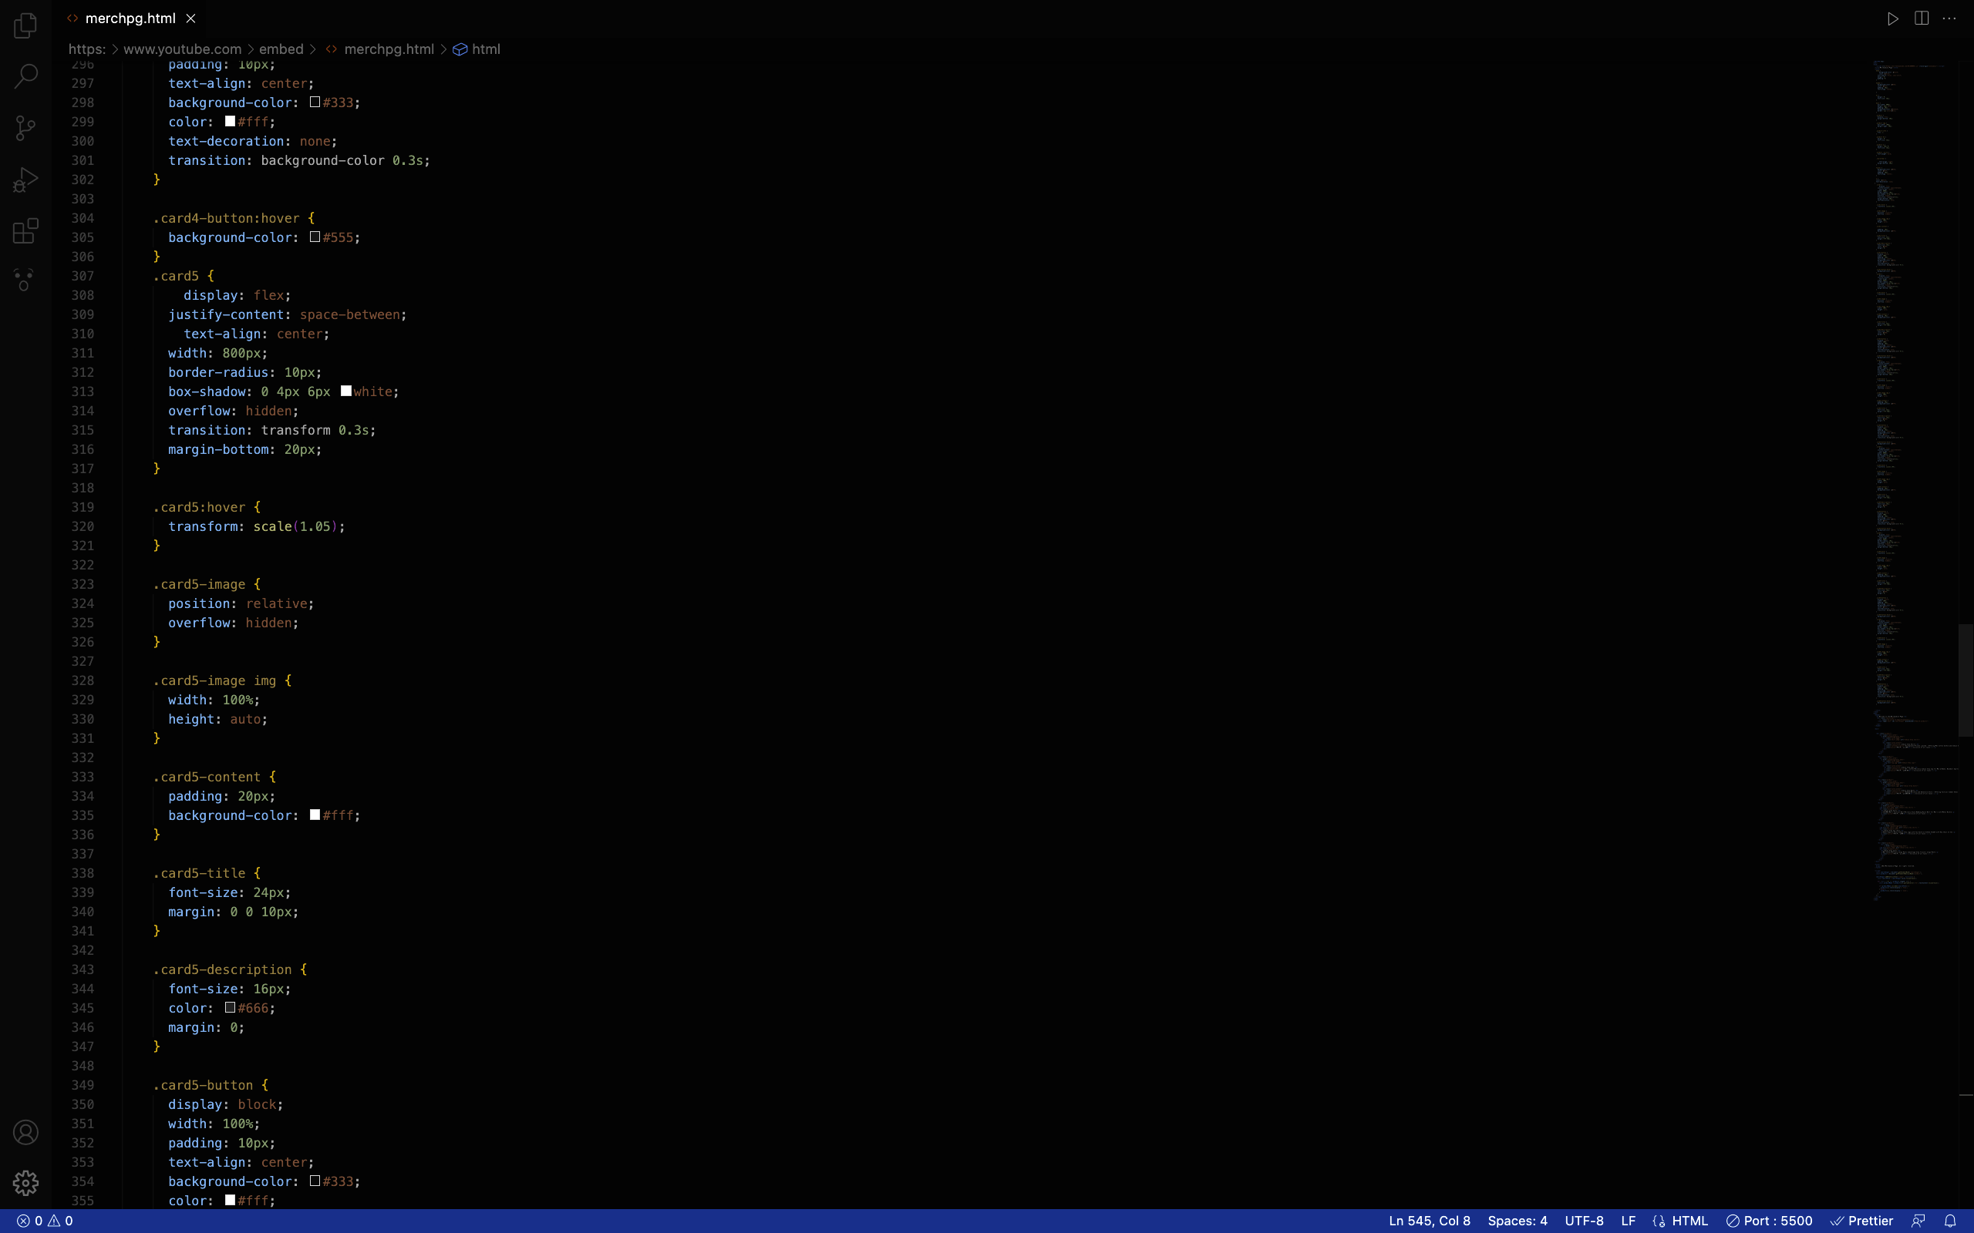
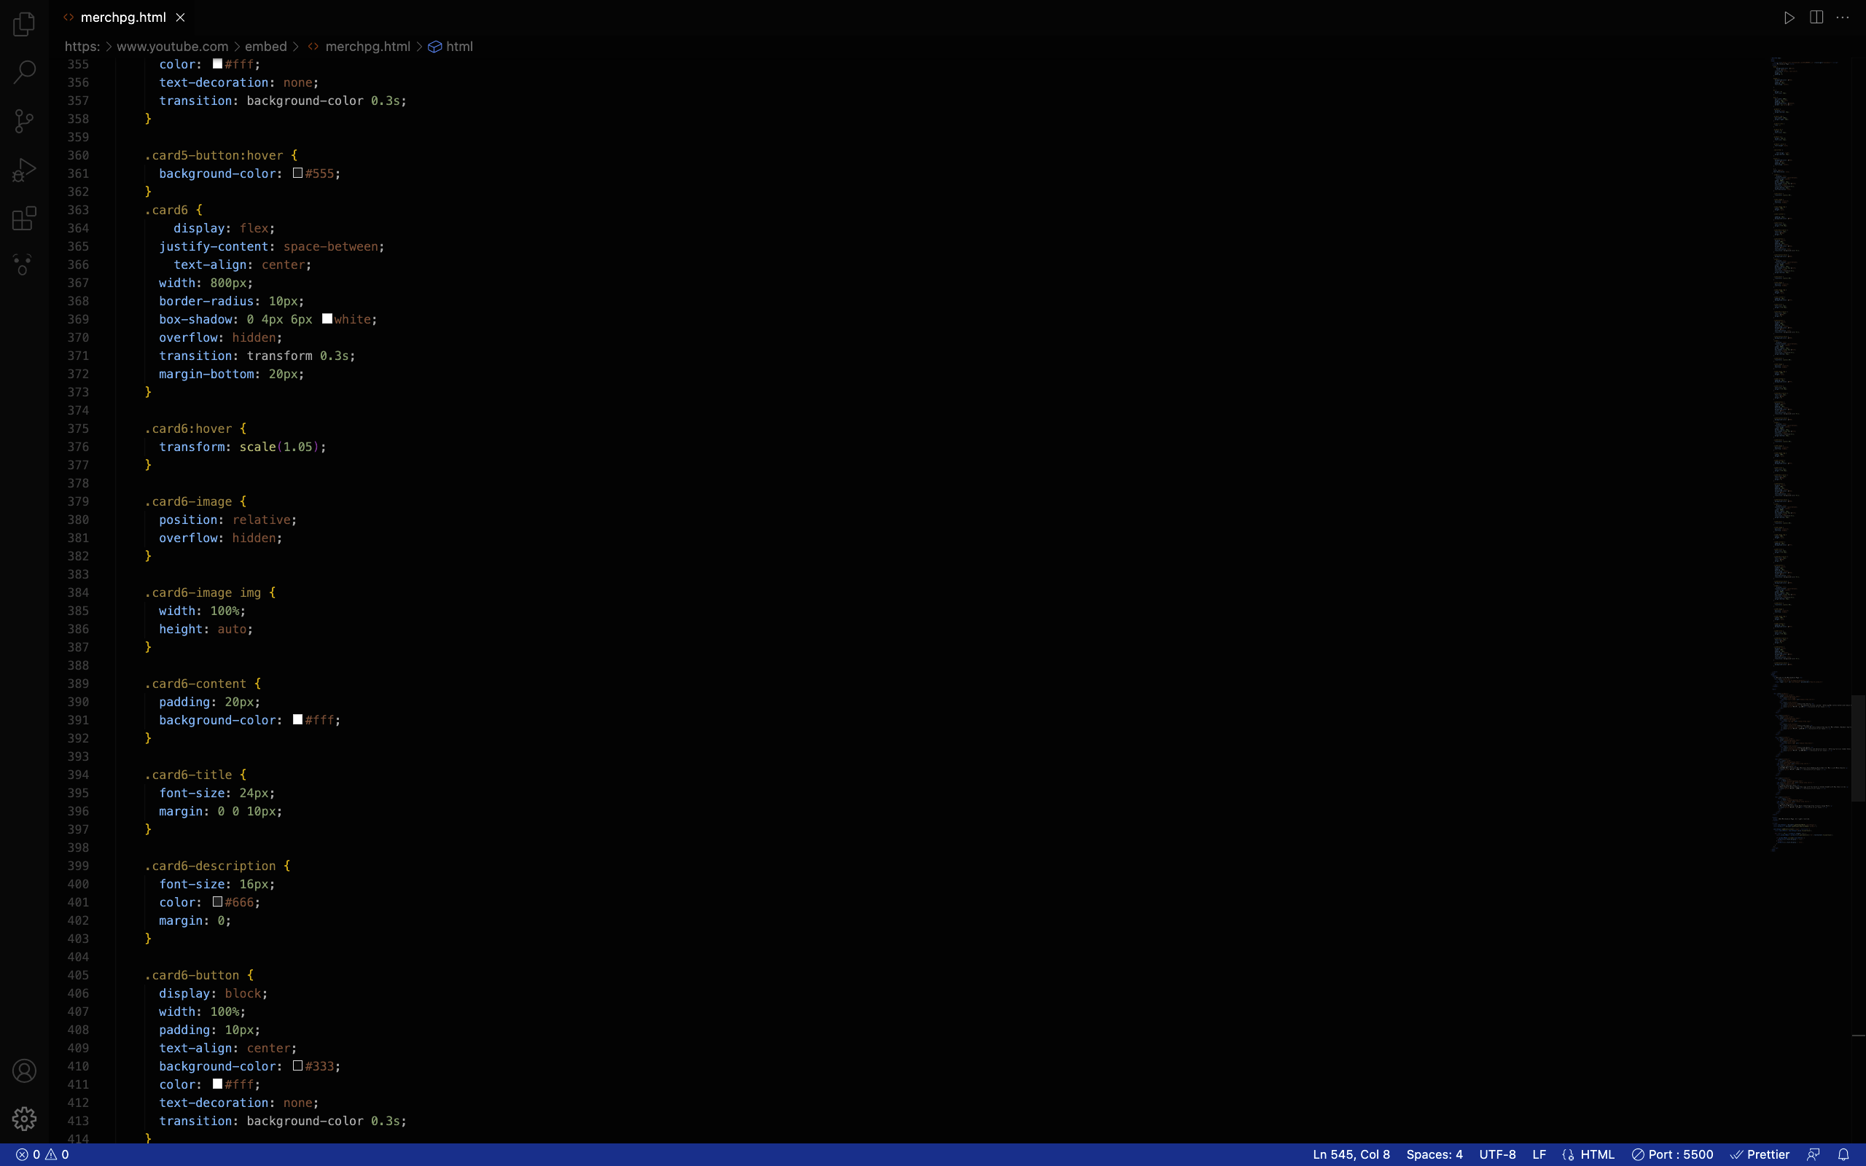
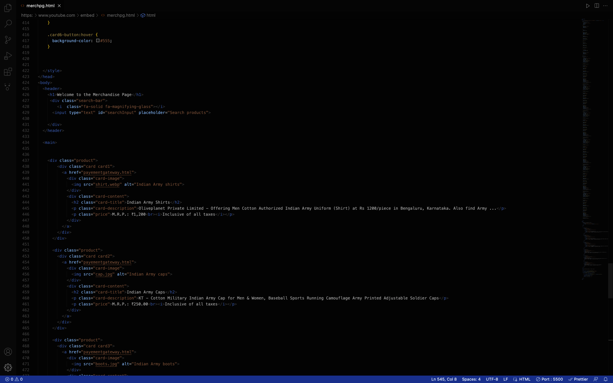

Slide 22
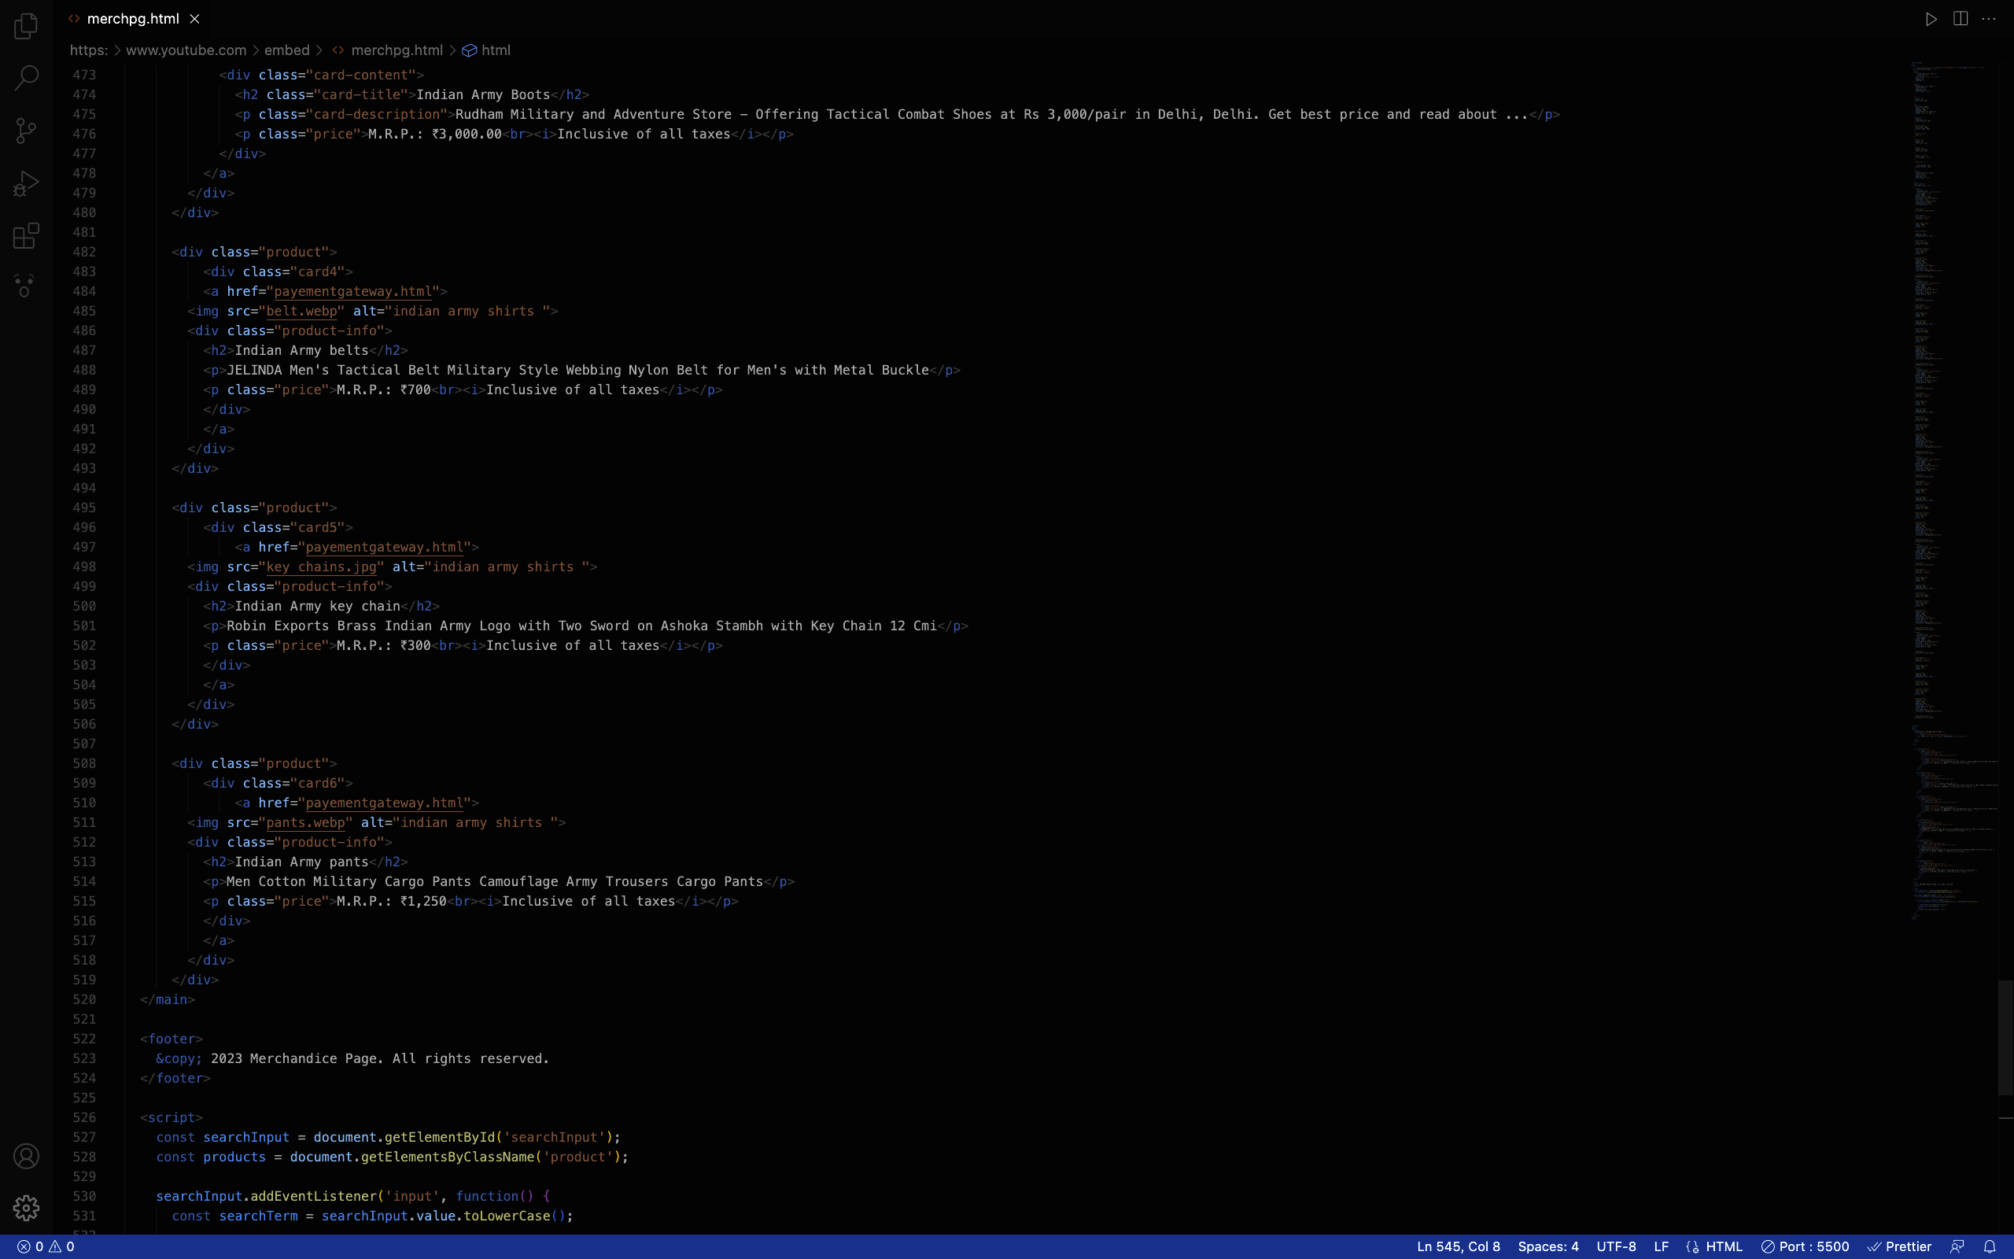
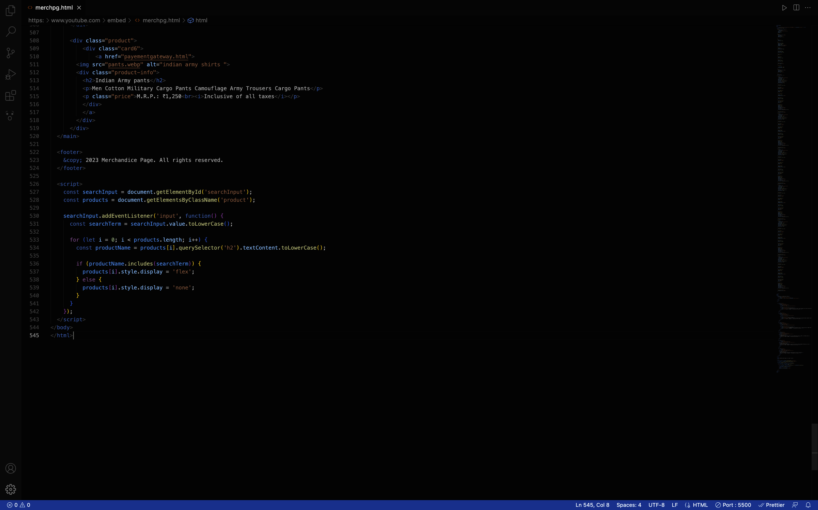

Slide 23
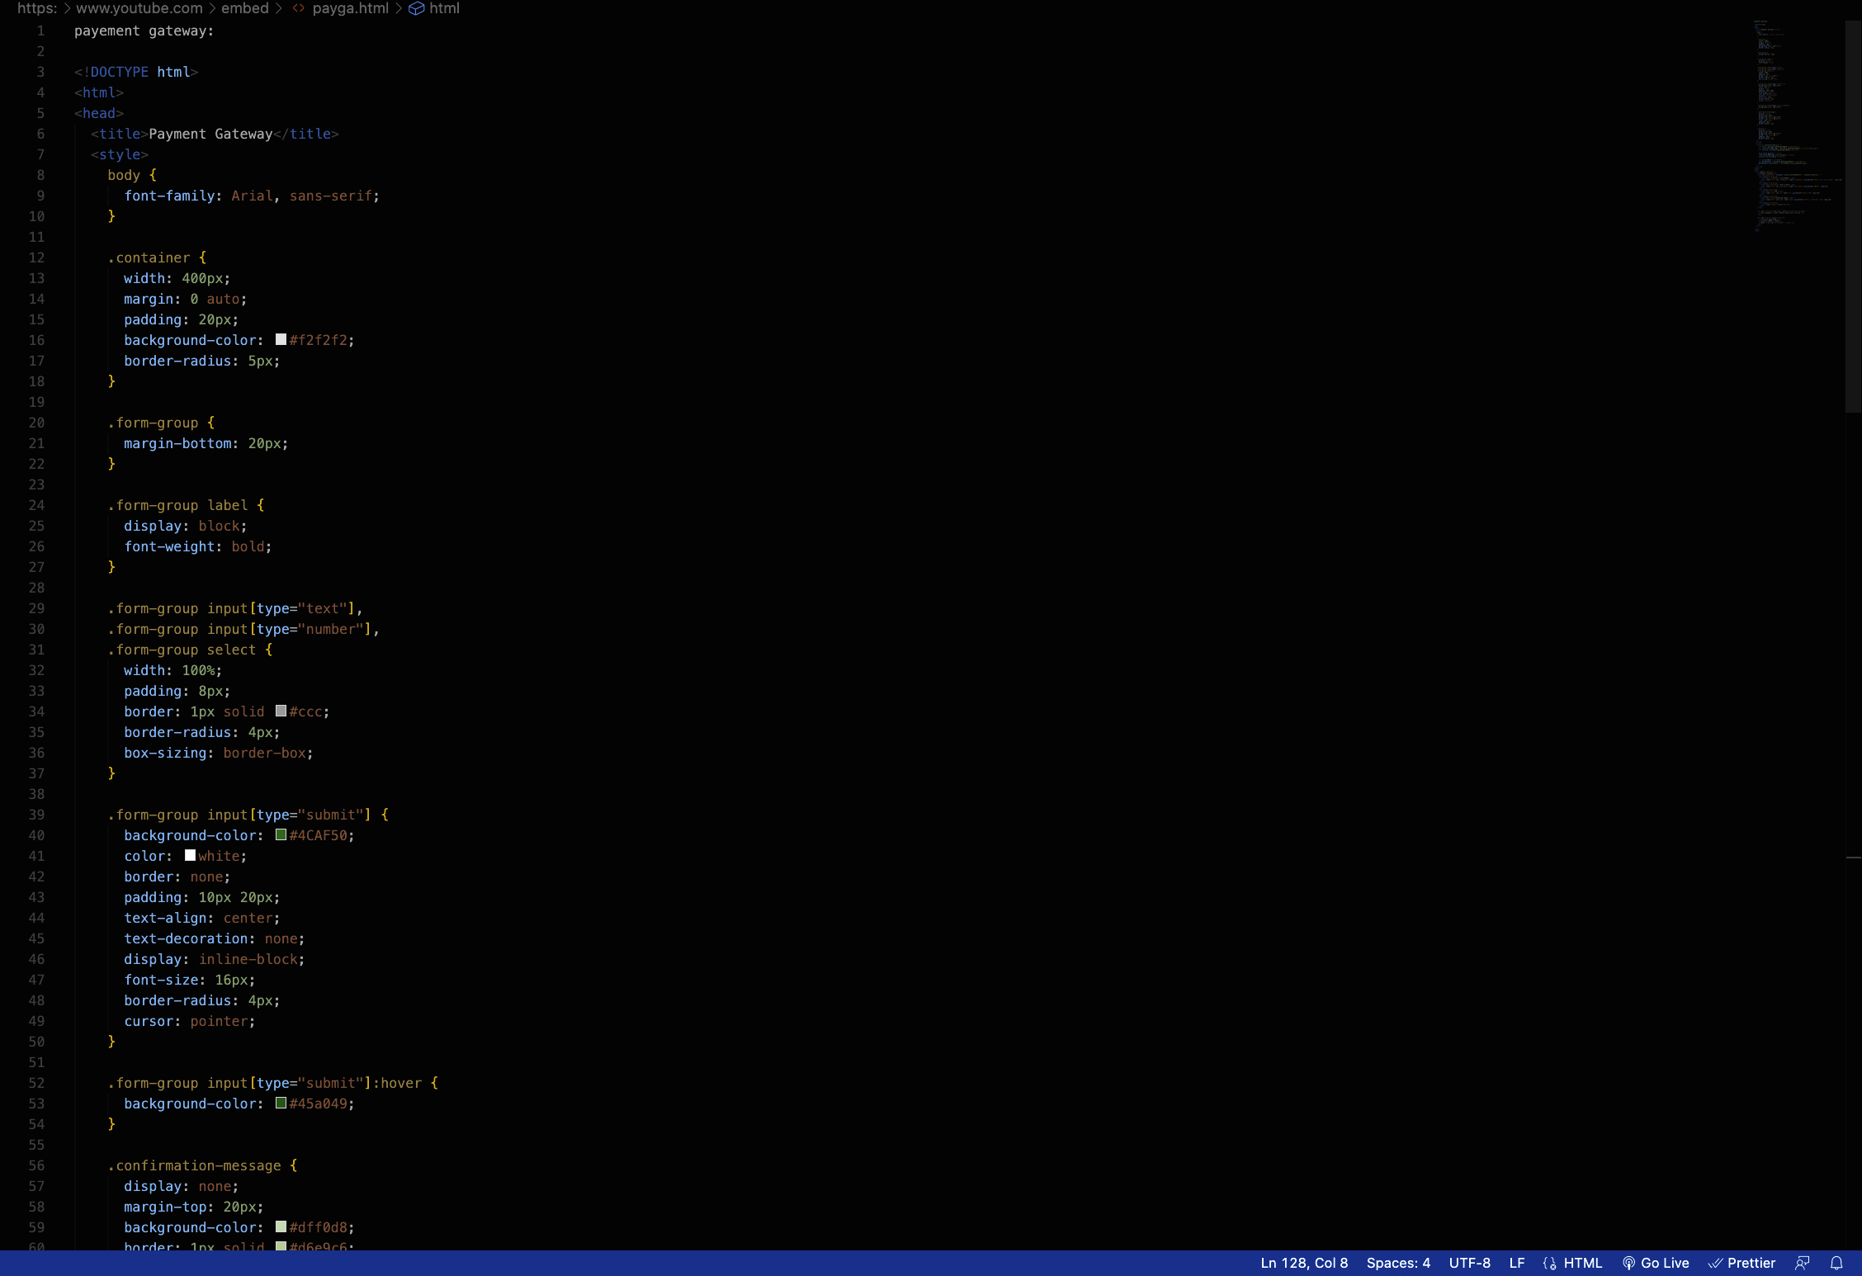
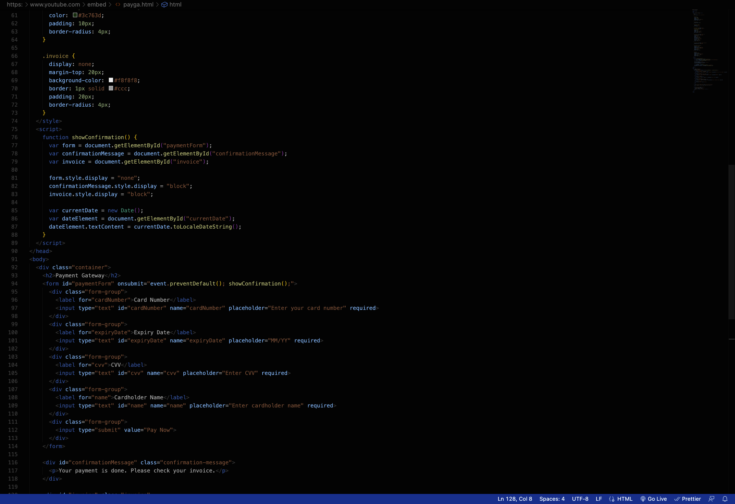
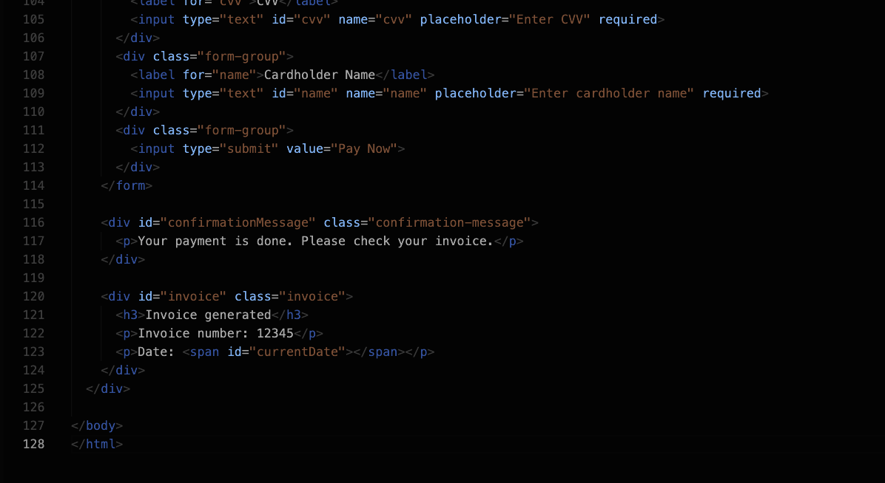
HTML/CSS code snippets for Payment Gateway Page:

Slide 24
Conclusion
The main takeaway experience from our project is the opportunity to honour and pay tribute to the Indian Defense Forces and their contributions to the nation. Through our website, users can learn about the history of wars and about the brave soldiers who have sacrificed their lives to protect the country.
Furthermore, the tribute page provides a platform for users to express their gratitude and appreciation for the sacrifices of the fallen heroes by sharing their written tributes. This feature can help to promote a sense of patriotism and unity among users.
In addition, our project has future scope for expansion, including collaborations with the Indian Defense Forces, integration with social media platforms, and the development of mobile applications. By incorporating these features, our project can continue to grow and reach a wider audience, while promoting awareness and support for the Indian Defense Forces.
Overall, the main takeaway experience from our project is the ability to honour and pay tribute to the brave soldiers who have sacrificed their lives for the nation, and to promote a sense of patriotism and unity among users.

Slide 25
References/Links used
www.google.com
wikipedia.com
youtube.com

Slide 26


